Slide 1
India.

Slide 2
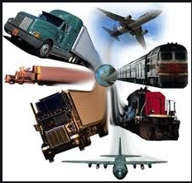
We are learning about Indian transport.

Slide 3
The main methods of travel in India are similar to those in the United Kingdoms – cars, buses, planes, trains and bicycles but as the cities are so busy, roads can be very chaotic.

Slide 4
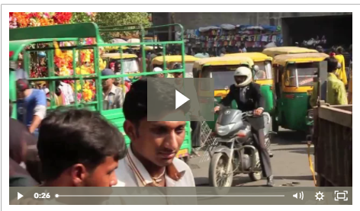
Visit this webpage and find out about transport in India.
https://www.oddizzi.com/teachers/explore-the-world/country-close-up/case-study-india/living-in-india/transport-2/

Slide 5
Tasks
How many different vehicles did you see? Were there any that vehicles that are not seen in the UK?
Can you draw a picture of a Tuk Tuk ?
What different animals did you see being used as transport?

