Slide 2
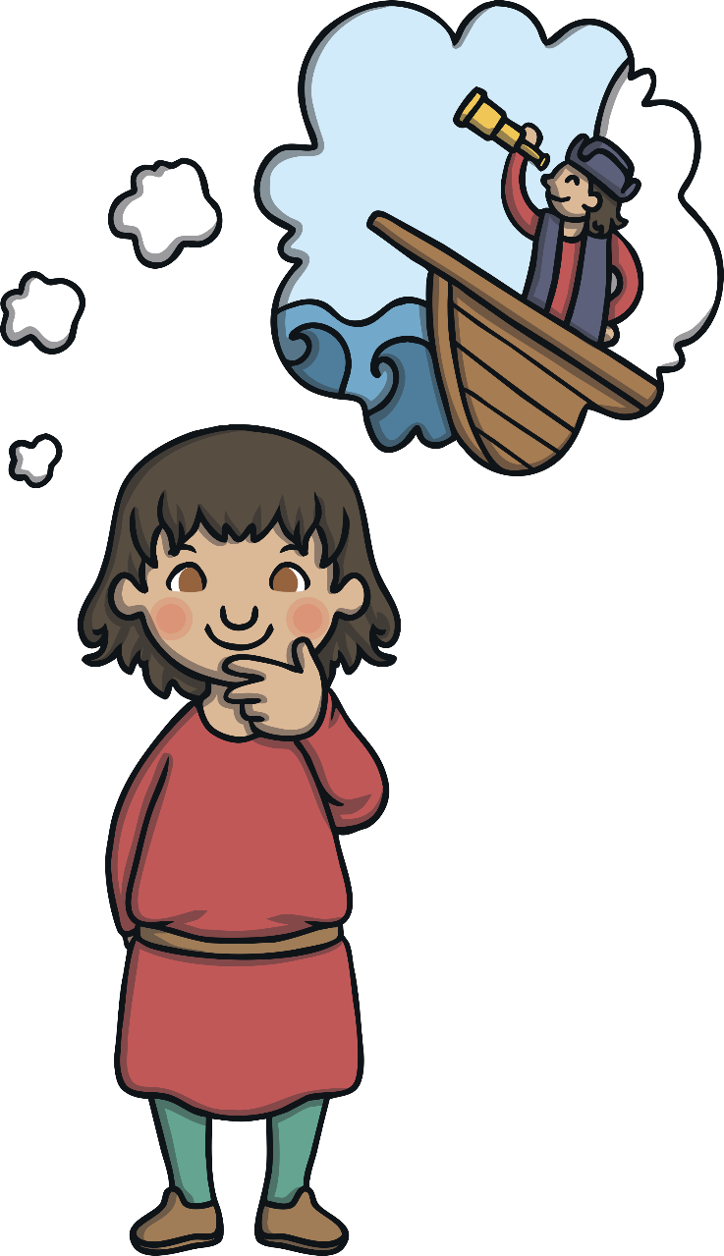
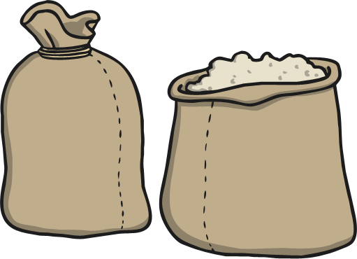
Christopher Columbus was born in Genoa, Italy, which was a very busy port. His father wove and sold wool, hoping to get rich by selling it to others.
At the age of 13, young Christopher went to sea, hoping to return home a rich man having sold the family wool. While at sea, he learned about the winds and the tide. He also learned how to find his way by looking at the stars and the Sun.

Slide 3
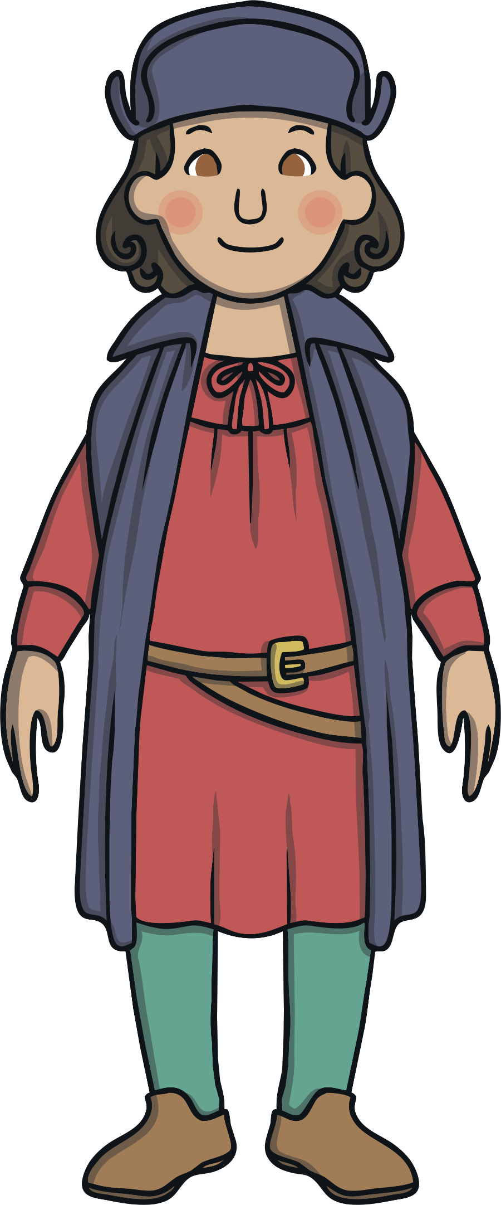
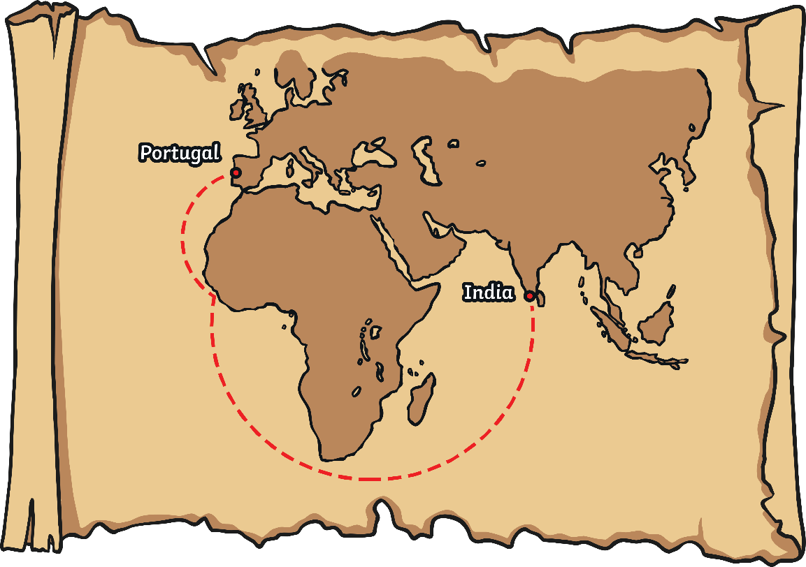
Later in his life, Columbus realised that people wanted to begin trading with countries in the east, such as China and India, but nobody was quite sure of the fastest way to get there. Columbus’ map reading skills told him that sailing west to China was the best idea but many people thought that this was a ridiculous idea. He tried to persuade rich people to help him but they laughed at his plan.

Slide 4
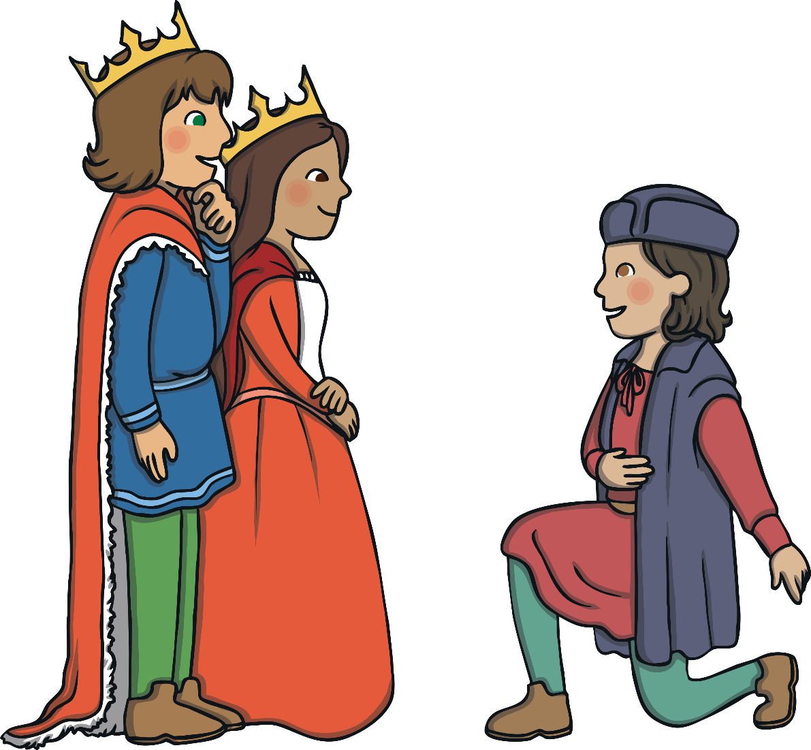
Finally, the King and Queen of Spain gave Columbus the money that he needed for ships and promised him royalties on his return.

Slide 5
Columbus set sail on the 3rd of August 1492 with three ships, the Niña,
the Pinta and the Santa Maria. Each ship had space for about 30 men.
It wasn’t a comfortable journey; men had to work in shifts and sleep on the deck. The ships let water in so the men had to work pumps to stop the ships from sinking.

Slide 6
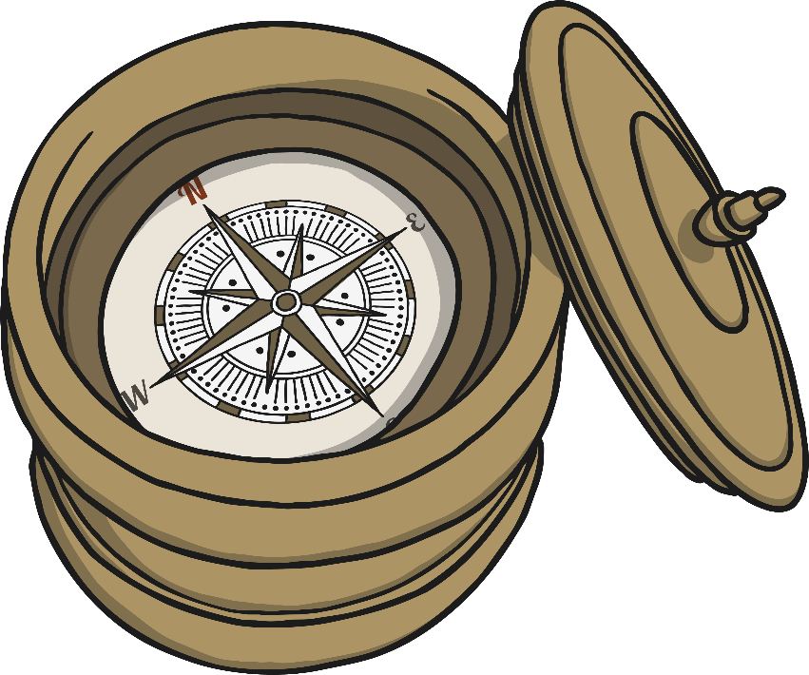
Using a compass, Columbus navigated the way but the journey was taking much longer than anyone had thought. The men got scared because their food and water supplies were running very low.
36 days after setting sail, an island was spotted in the distance. Columbus named the island San Salvador; it was an island in
the Bahamas.

Slide 7
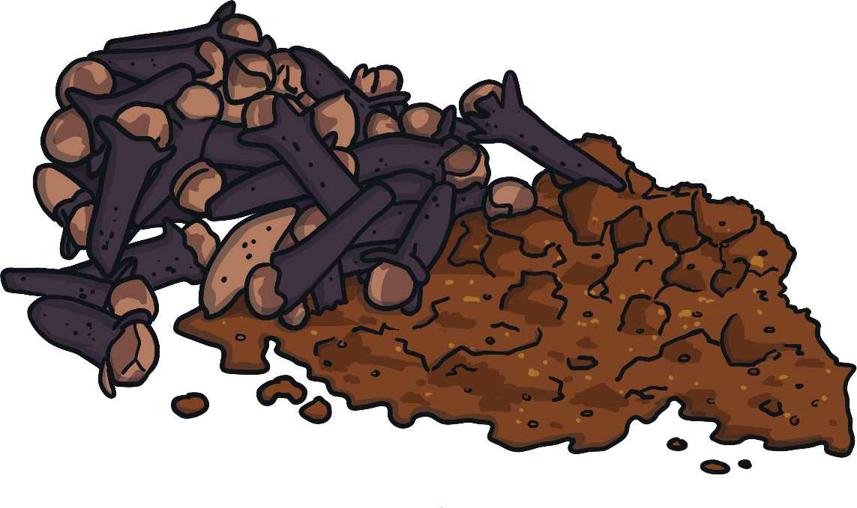
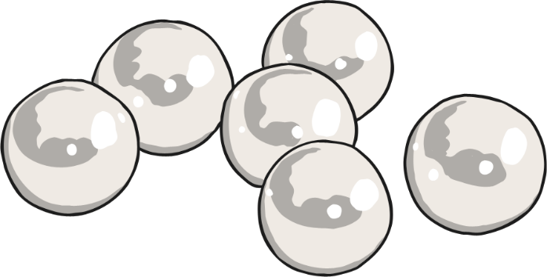
For months, Columbus sailed around the nearby islands looking for ‘gold, silver, pearls, precious stones, spices and other expensive objects’ that he had promised the Spanish King and Queen on his return. However, he did not find much.

Slide 8
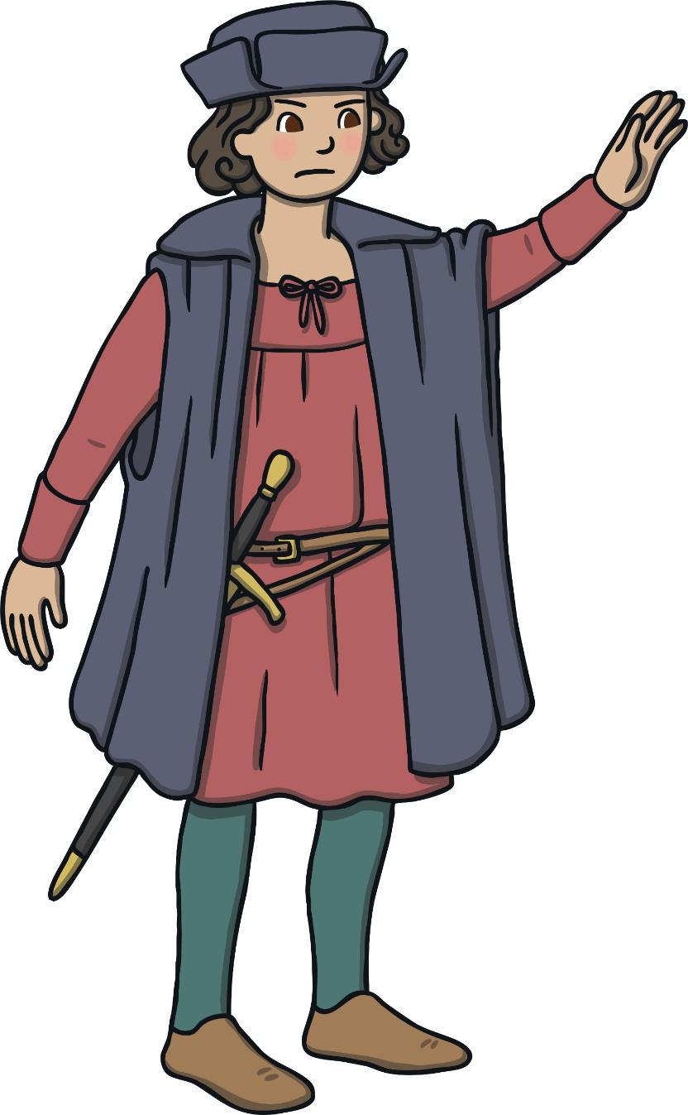
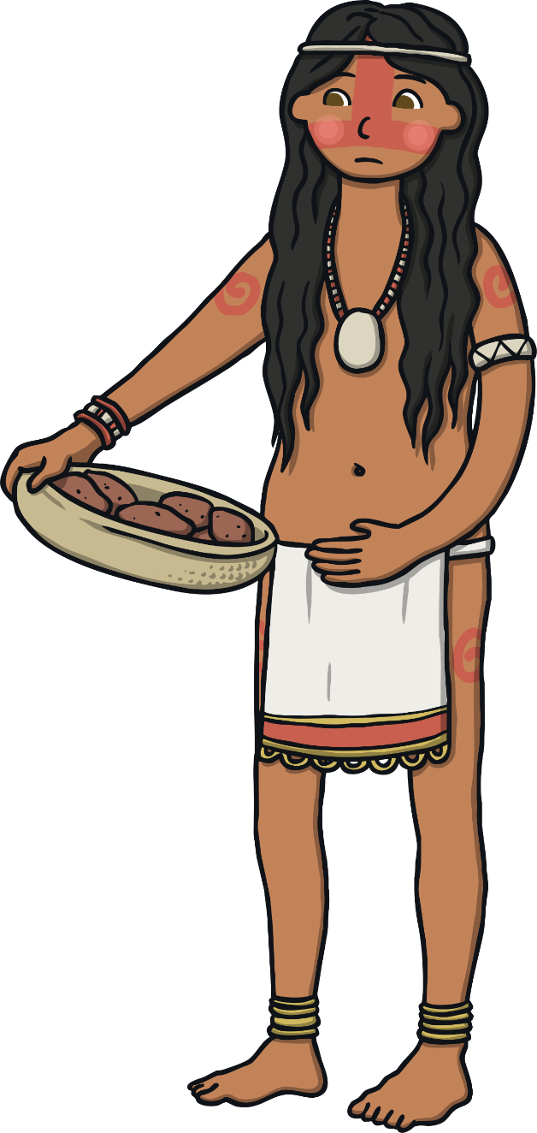
Christopher was the first person from Europe to explore these islands, which became known as the 'New World’.
There were people already living on the islands and they weren't very happy as Columbus took these islands from the people and claimed them for Spain.
Think About It
Do you think it was fair that the islands became known as the ‘New World’?

Slide 9
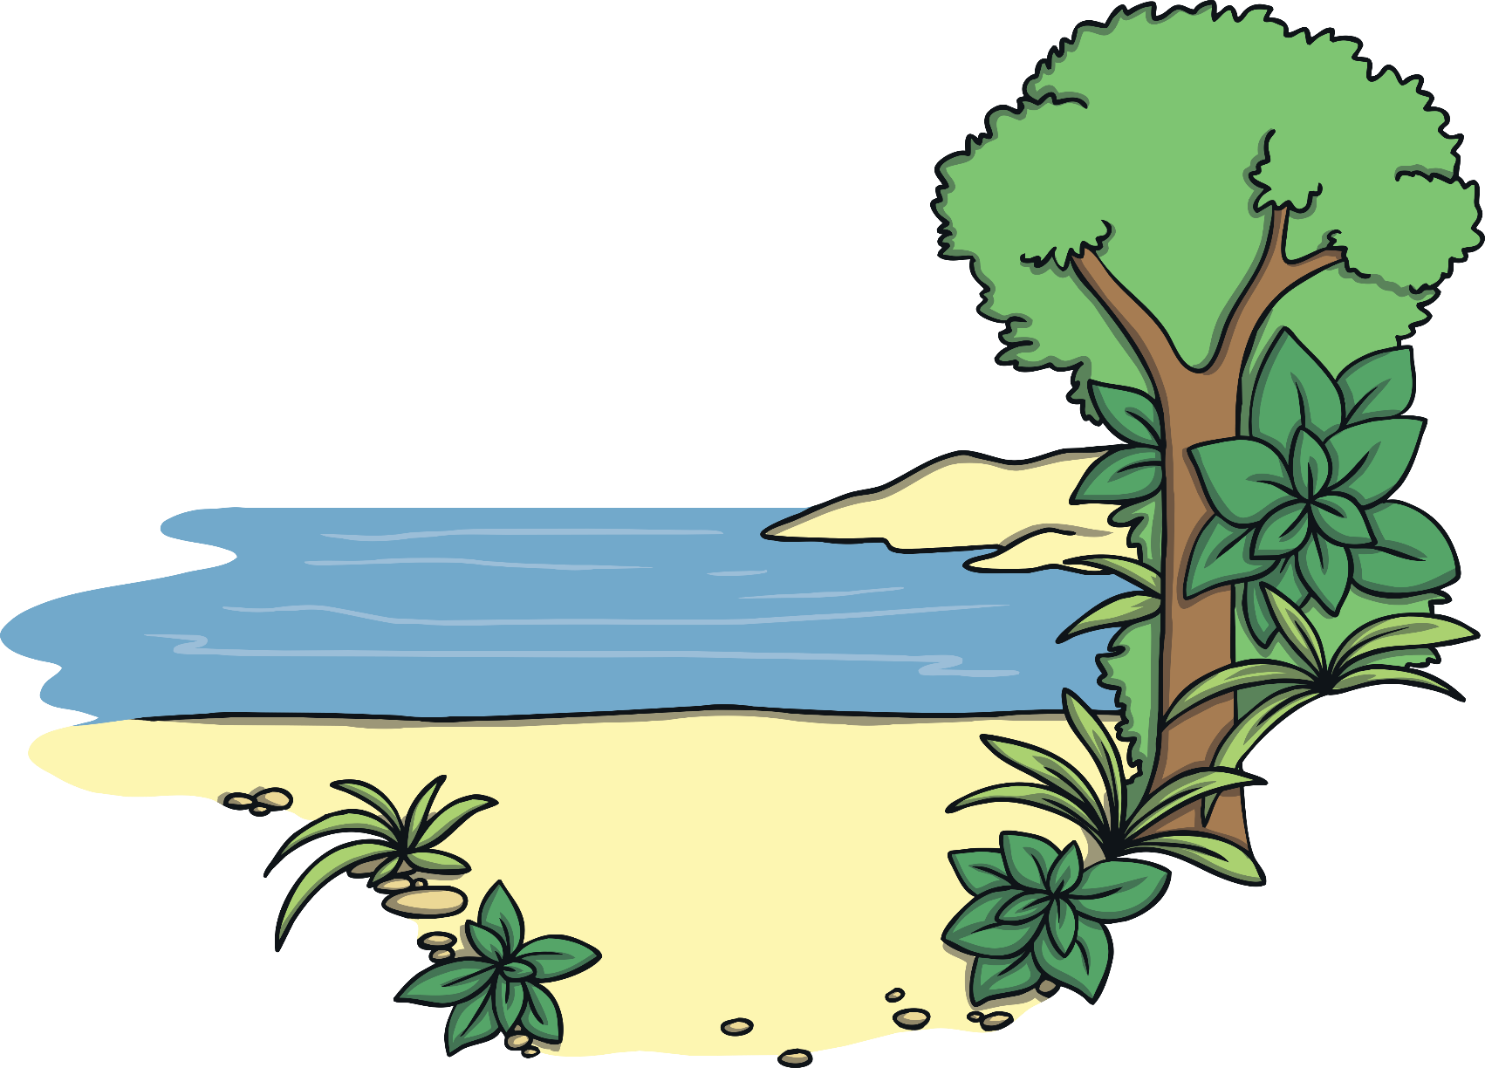

Sadly, the islanders had no weapons to defend themselves and when Columbus showed them a sword, they had no choice but to surrender. He took some of the native people back with him, where they
became enslaved.
Think About It
What would you have done if you were travelling with Columbus and saw him acting this way?

Slide 10
On the journey back to Spain, Santa Maria hit a reef and was wrecked.
The other two ships made it home safely. Columbus went back to save his men but by that time, they had all died.

Slide 11
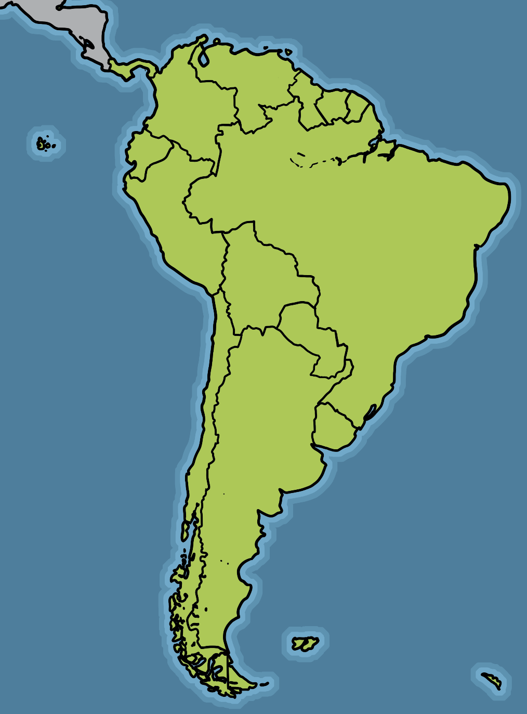
Spain now ruled over the islands which he discovered.
Columbus returned a number of times and eventually visited South America.
Think About It
Do you think Columbus is a hero, villain or something in-between? Why?

Slide 12
On his return, he was diagnosed with arthritis, which caused his body much pain.
The King and Queen did not award him as promised as they thought he was not mentally well.
On 20th May 1506 Columbus’ health took a turn for the worst and he died, aged 54.
Today, he is remembered as a ‘path-breaking explorer’ who transformed the new world. However, his actions created changes that would devastate native populations.
Think About It
There is a Columbus Day to celebrate his achievements. Do you think Columbus should be glorified?

Slide 13
How old was Columbus when he first went to sea?
A
15
B
10
C
13

Slide 14

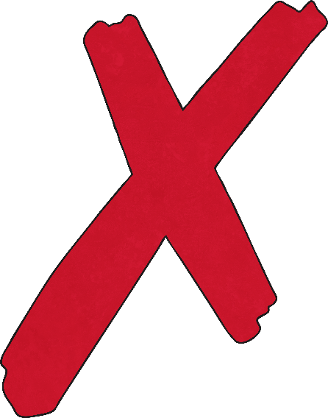
Never mind, Keep trying!

Slide 15

Correct!

Slide 16
Who gave Columbus the money for his exploration?
A
his parents
B
The King and Queen of Spain
C
his friends

Slide 17
Never mind, Keep trying!

Slide 18
Correct!

Slide 19
How many men could fit aboard the Santa Maria?
A
30
B
300
C
3000

Slide 20
Never mind, Keep trying!

Slide 21
Correct!

Slide 22
What did Columbus use to navigate his journey?
A
binoculars
B
a compass
C
a watch

Slide 23
Never mind, Keep trying!

Slide 24
Correct!

Slide 25
What did Columbus name the new islands
he discovered?
A
‘New Islands’
B
‘New Land’
C
‘New World’

Slide 26
Never mind, Keep trying!

Slide 27
Correct!

Slide 28
What was the name of the ship that was wrecked when it hit a reef?
A
Santa Maria
B
Santa Marie
C
Santa Margot

Slide 29
Never mind, Keep trying!

Slide 30
Correct!

Slide 31
Who took over the rule of the Islands that
Columbus discovered?
A
South America
B
Great Britain
C
Spain

Slide 32
Never mind, Keep trying!

Slide 33
Correct!

