Slide 1
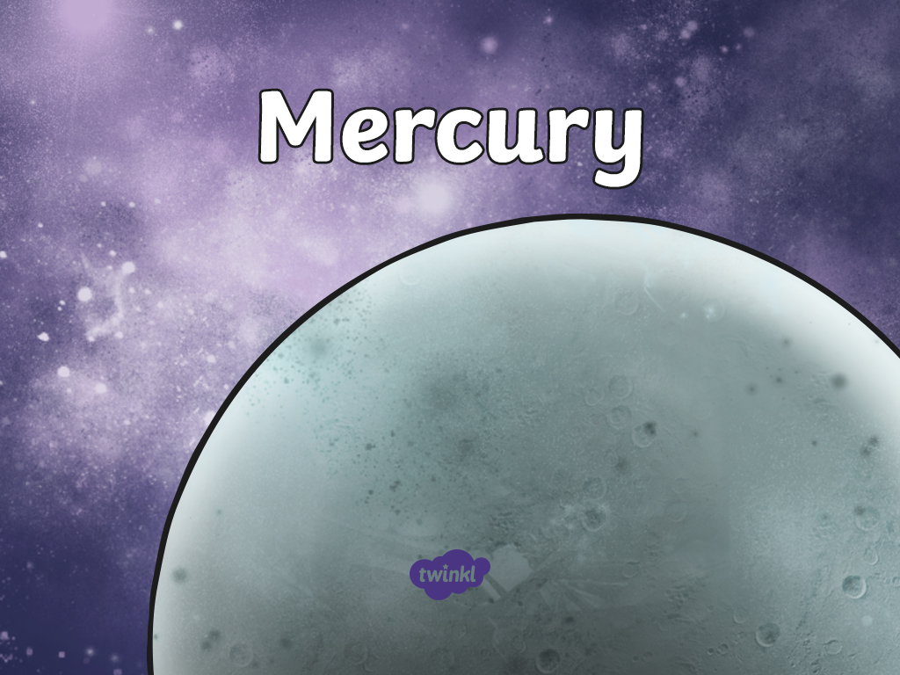

Slide 2

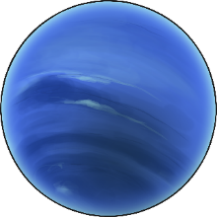
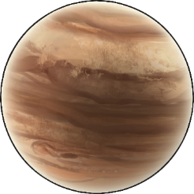
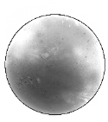
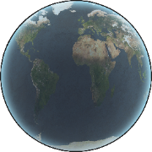

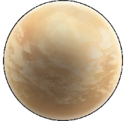
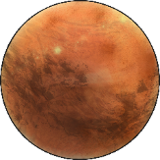
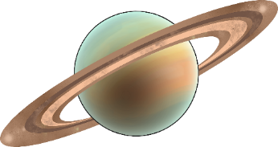
Earth is only one of the planets in our solar system. There are seven other planets that also orbit our Sun.
Neptune
Jupiter
Mercury
Earth
Uranus
Venus
Mars
Saturn

Slide 3
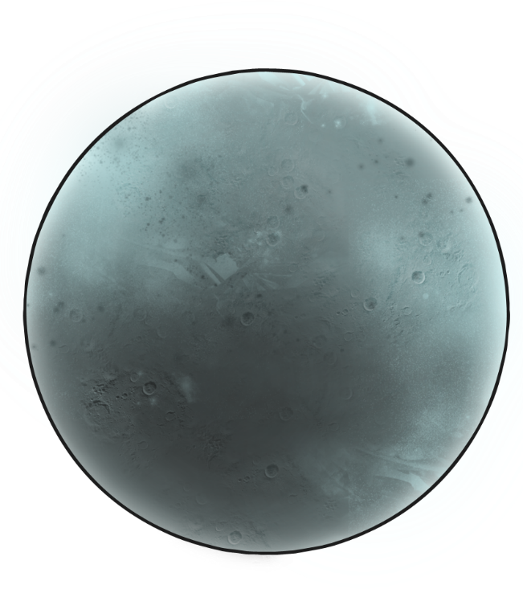
The Closest Planet
The planet Mercury is the closest planet to the Sun. It is also the smallest planet in our solar system. It is 77 million km (55 million miles) away from Earth.

Slide 4
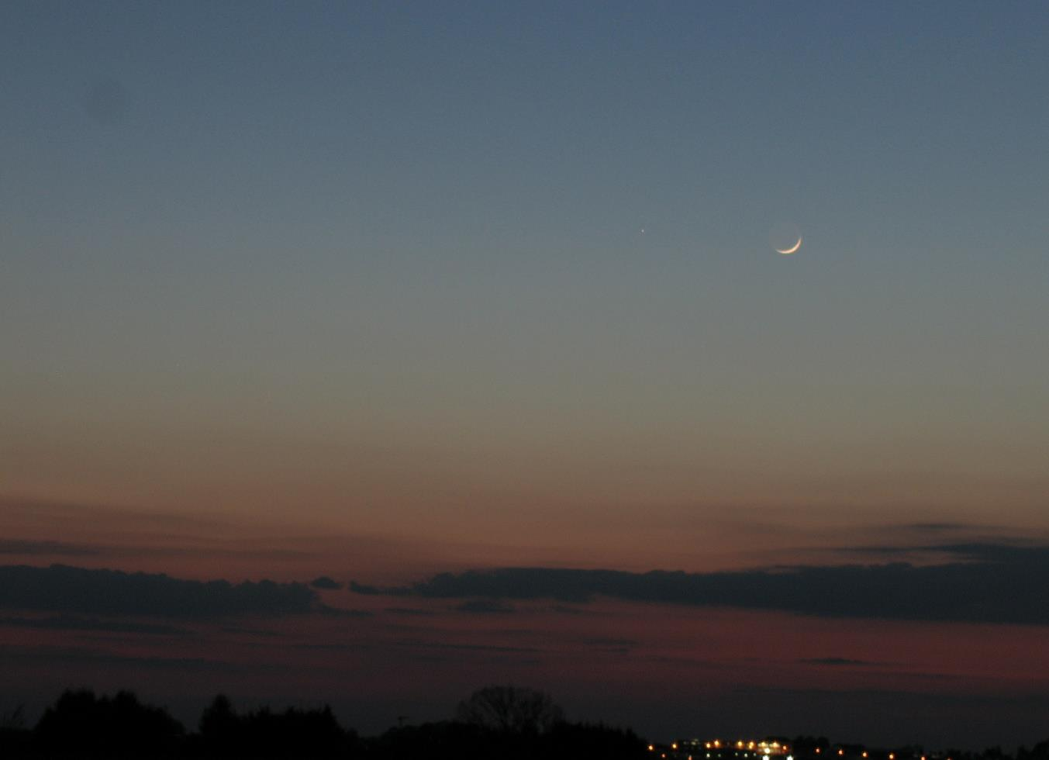
Mercury
It is sometimes possible to see Mercury in the sky at night, but it can be very hard to spot.

Slide 5
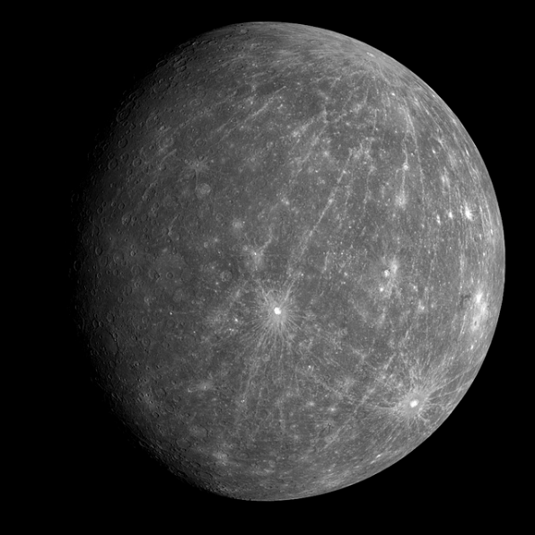
Mercury is a tiny planet, about the same size as the Moon!
It is rocky, dusty and covered in craters from being hit by objects floating through space.
It also has some volcanoes on its surface!

Slide 6
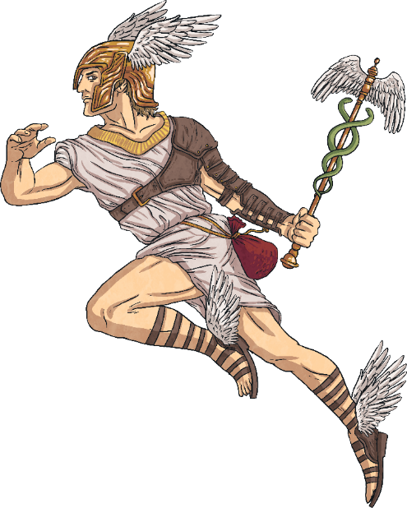
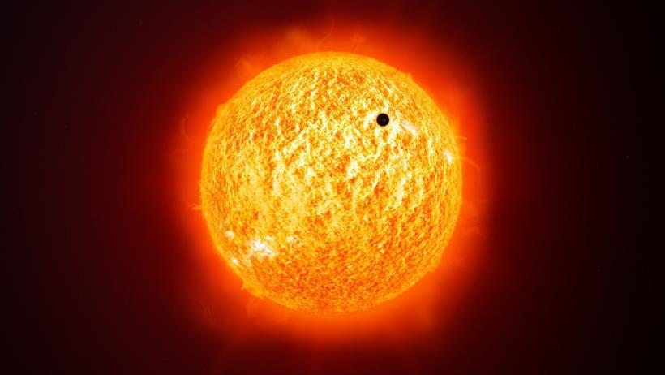
Mercury is the fastest moving planet in the solar system. It zooms around the Sun in only 88 days!
This is why it is named Mercury, after the swift Roman messenger god.

Slide 7
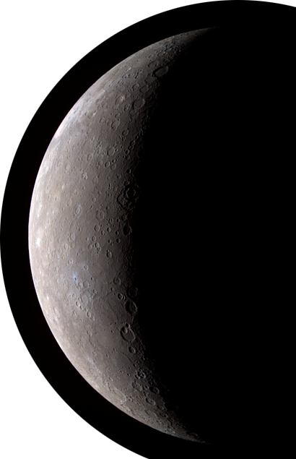
Mercury and Earth
Mercury is very different to Earth.
On Mercury, 1 day lasts the same as 59 days on Earth!
The surface of Mercury gets extremely hot when in sunlight, much hotter than anywhere on Earth. The parts of the surface out of the sunlight get extremely cold, much colder than anywhere on Earth!
Mercury does not have any moons.

Slide 8
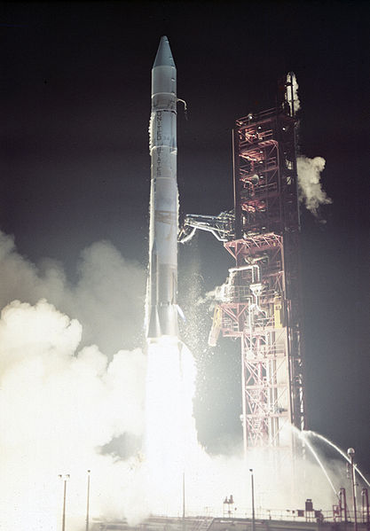
Exploring
Humans have known about Mercury for thousands of years. However, it was only recently that technology meant we could study Mercury more closely.
In 1974, the Mariner 10 spacecraft performed 3
fly-pasts of Mercury and took photographs of about half of its surface.

Slide 9
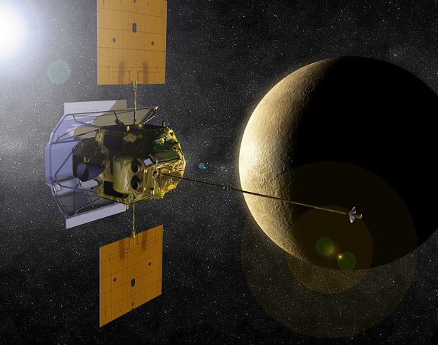
The MESSENGER Mission
In 2008, the MESSENGER probe performed 3 fly-pasts, taking photographs of Mercury.
In 2011, MESSENGER entered Mercury’s orbit. It took close-up photographs of the planet’s surface, including volcanoes, craters and valleys. It also collected information on what Mercury is made from.
It finished its mission in 2015 and crashed into the planet’s surface.

Slide 10
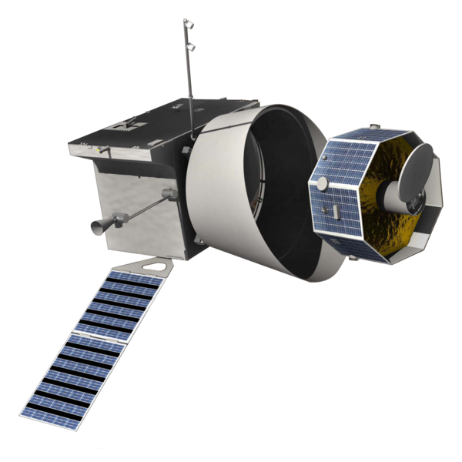
The BepiColombo Mission
In October 2018, the BepiColombo mission to Mercury launched. It is hoped that it will reach Mercury in 2025 in order to learn more about the planet.
BepiColombo is named after Guiseppe “Bepi” Colombo, an Italian scientist who worked on the Mariner 10 mission and died in 1984.

Slide 11
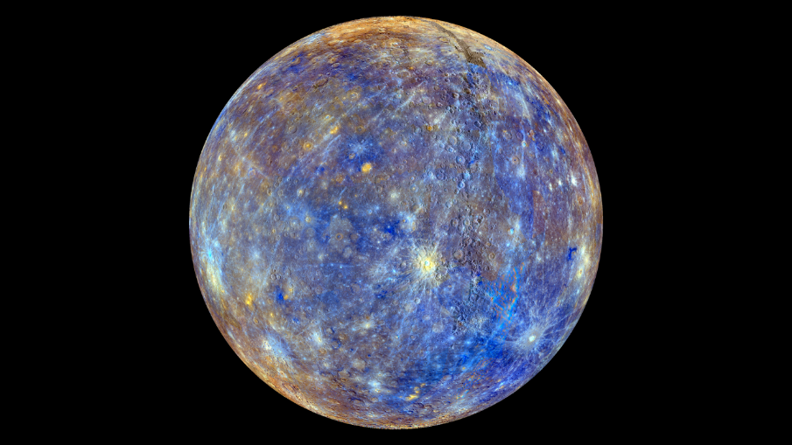
Photographs of Mercury
A photograph of Mercury taken by the MESSENGER probe in 2008. The colourful image is how the spacecraft sees Mercury before the colours are changed by scientists to show what our eyes would see.
“False Color View of Mercury” by NASA Goddard Space Flight Center is licensed under CC BY 2.0

Slide 12
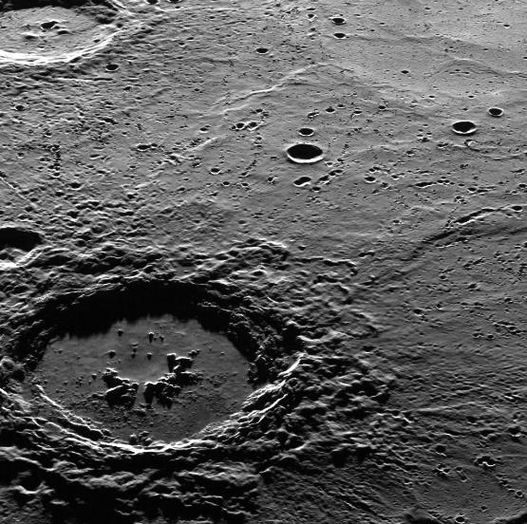
Photographs of Mercury
A close-up photograph of Mercury’s surface, showing lots of craters up close in detail. This image was taken by the MESSENGER probe in 2008.
“Hi, Hokusai!” by NASA Goddard Space Flight Center is licensed under CC BY 2.0

Slide 13
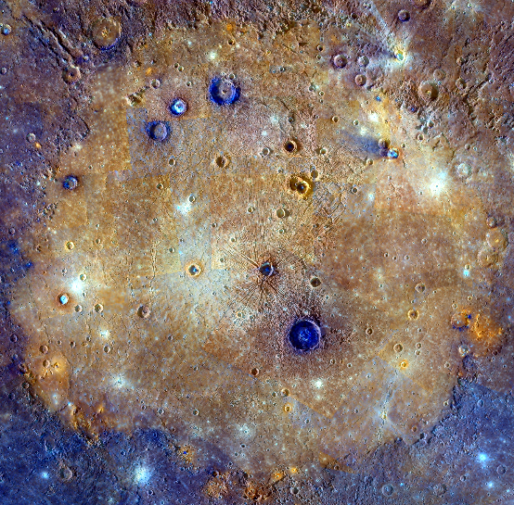
Photographs of Mercury
This image of Mercury captured by the MESSENGER spacecraft in 2008 shows ‘Cloris Planitia’, a huge impact site. This is the large orange area in the picture.
“It's All About That Basin” by NASA Goddard Space Flight Center is licensed under CC BY 2.0

Slide 14
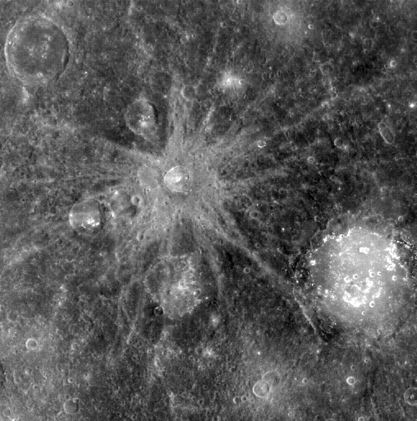
Photographs of Mercury
This photograph shows some of Mercury’s craters close up in detail. This image was taken by the MESSENGER probe in 2008.
“Bek and Lermontov” by NASA Goddard Space Flight Center is licensed under CC BY 2.0

Slide 15
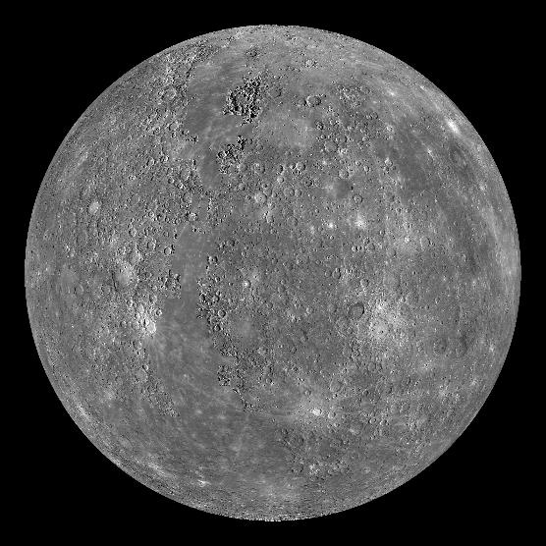
Photographs of Mercury
A detailed photograph of Mercury taken by the MESSENGER probe in 2011.

Slide 16
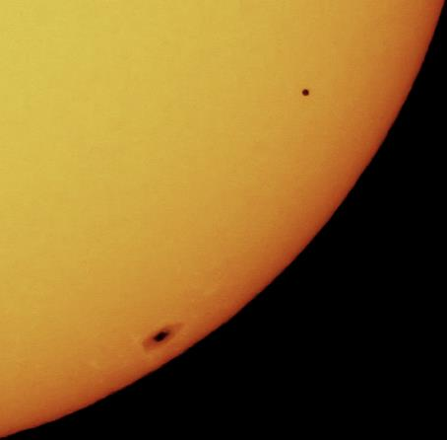
Photographs of Mercury
This photograph shows Mercury passing in front of the Sun. This is known as the ‘Transit of Mercury’.
Seeing Mercury travel across the Sun from Earth only happens 13 times every 100 years!
The next time this is due to happen is the 11th November 2019.
“A Rare Transit of Mercury - Mercury on Sun” by Ed is licensed under CC BY 2.0

Slide 17
All About Venus

Slide 18

The Hottest Planet
The planet Venus is the hottest planet in the Solar System. It is the second planet from the Sun and 261 million kilometres away from Earth, our closest neighbour planet.

Slide 19
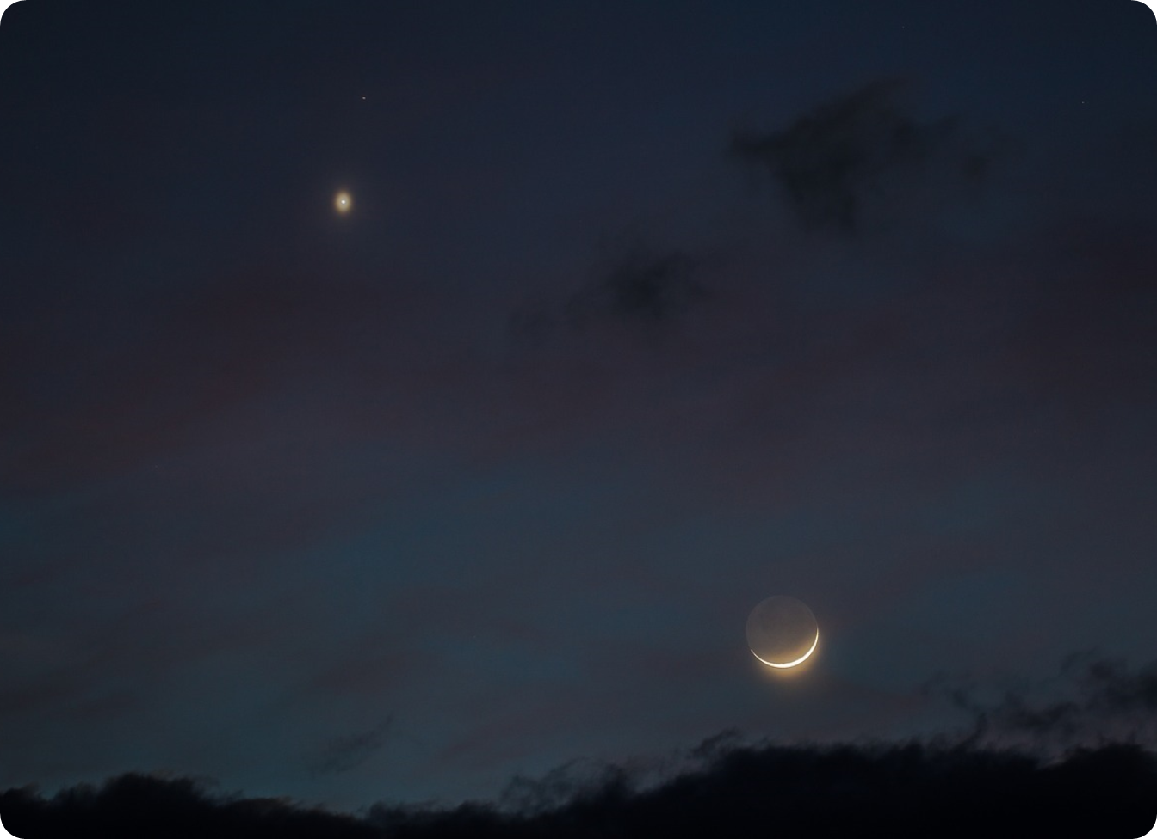

Venus is easily seen in the night sky. It is the brightest object in the sky apart from the Sun and the Moon.
“Venus Luna Conjunction” by astrometeo is licensed under CC BY 2.0

Slide 20
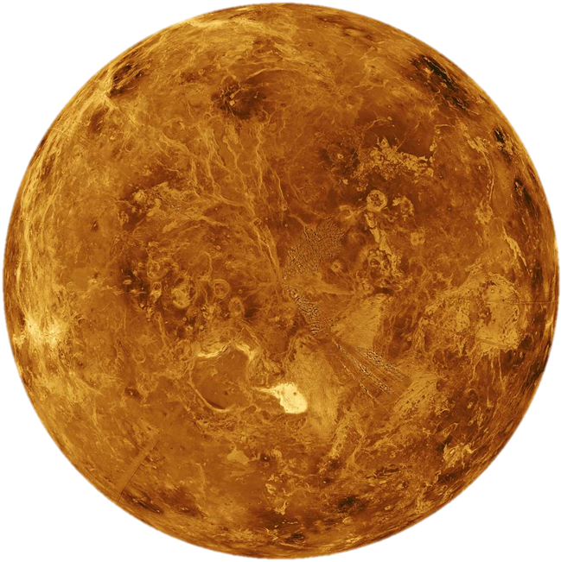
Venus is a rocky planet about the same size as Earth.
It has a thick atmosphere, which traps heat inside, causing Venus to be incredibly hot. The temperature on Venus is about 462°C, which is hot enough to melt some metals!
Venus is different from the other planets because it spins the other way around. It spins very slowly; one day on Venus is the same as 243 Earth days.
“Venus - Computer Simulated Global View of the Northern Hemisphere” by NASA is licensed under CC BY 2.0

Slide 21
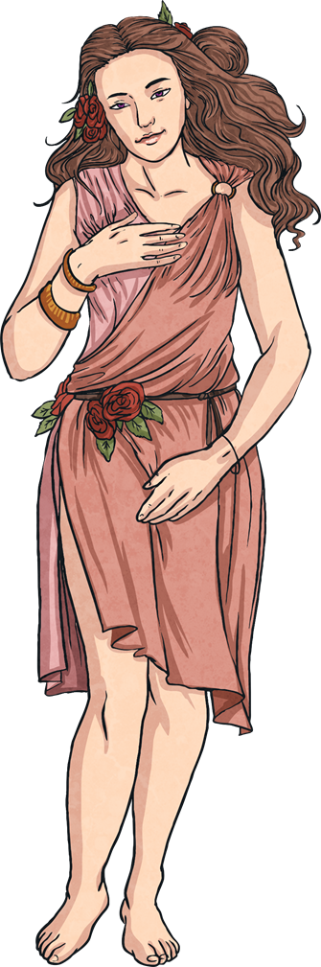

Venus is named after the Roman goddess of love and beauty.
A long time ago, Venus was thought to be two different stars called the ‘morning star’, as it sometimes appears in the sky before sunrise, and the ‘evening star’ because it appears in the night sky.

Slide 22
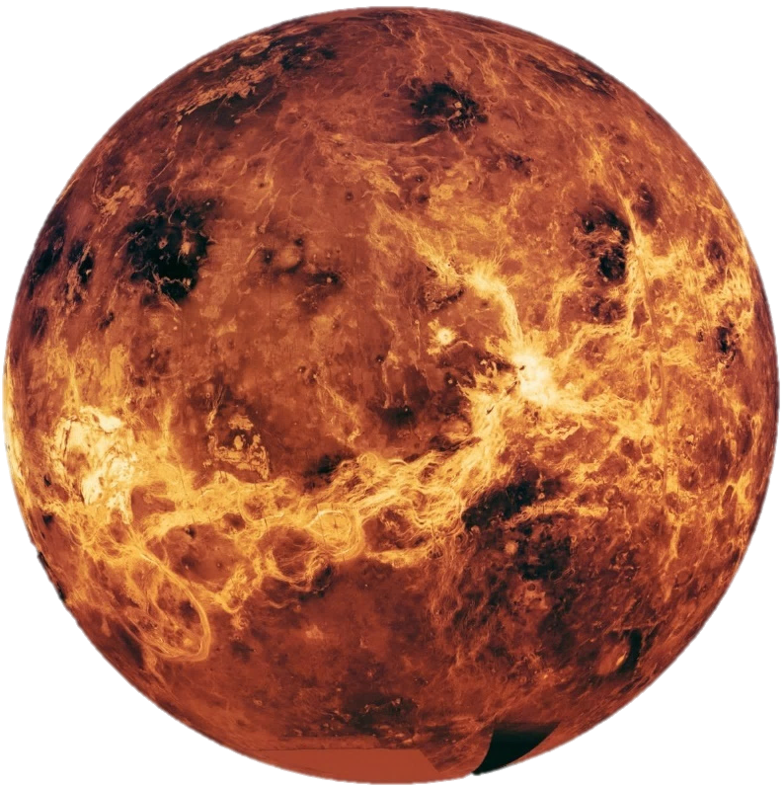
Venus and Earth
On Venus, a day is longer than a year! One day on Venus lasts 243 Earth days but a year (the time it takes for Venus to orbit the Sun) is only 224 Earth days!
Very rarely, Venus and Earth are at the same place in their orbit. Because of this, it is possible to view Venus move in front of the Sun. This is called a transit. The last transit of Venus was on 5th and 6th June 2012 and will not happen again until 10th and 11th December 2117.
Venus has no moons.
“Global view of Venus from Magellan, Pioneer, and Venera data” by NASA is licensed under CC BY 2.0

Slide 23
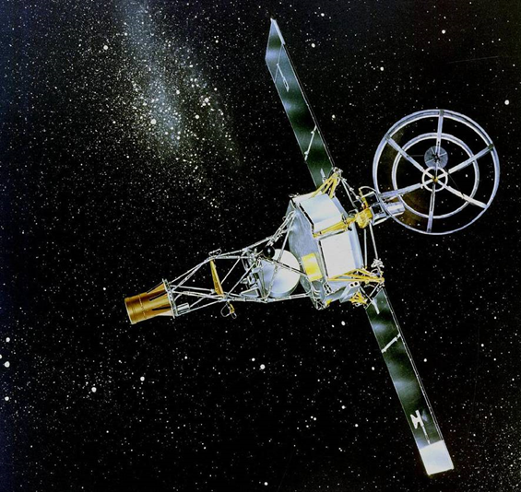
Exploration
Humans have known about Venus for thousands of years. However, it is only recently that we have had the technology to study our neighbouring planet close up.
The first space probe to visit Venus was Mariner 2 in 1962, which was the first craft to successfully encounter a different planet. Mariner 2 was able to measure the temperature of Venus and the planet’s atmosphere.
The success of Mariner 2 was followed by Mariner 5 successfully reaching Venus in 1967 and then by Mariner 10 in 1973.
“Mariner 2 Artist Concept” by NASA is licensed under CC BY 2.0

Slide 24
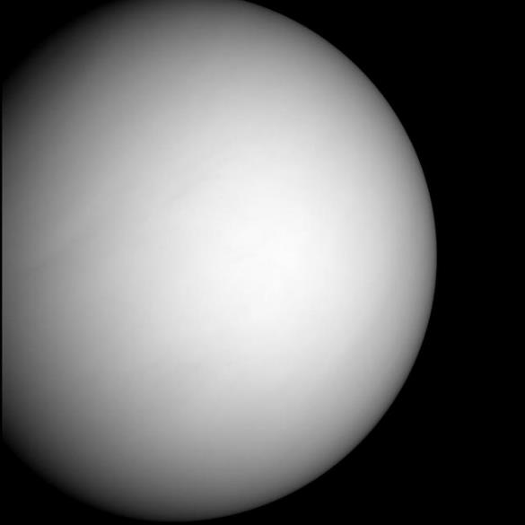
Pictures of Venus
An image of Venus taken by the MESSENGER probe on its way to Mercury in 2007.
“Approaching Venus” by NASA is licensed under CC BY 2.0

Slide 25
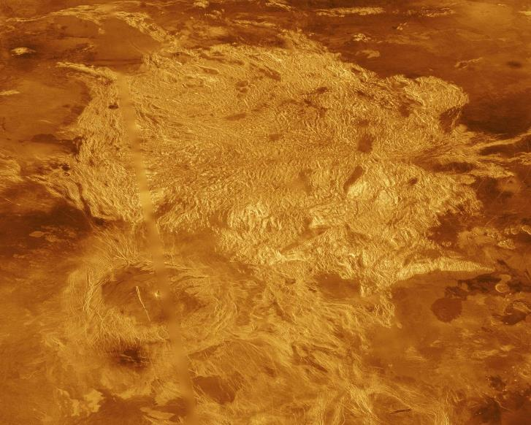
Pictures of Venus
A computer-generated snapshot of Venus’ surface as taken by NASAs Magellan spacecraft.
“Venus - Three-Dimensional Perspective View of Alpha Region” by NASA is licensed under CC BY 2.0

Slide 26
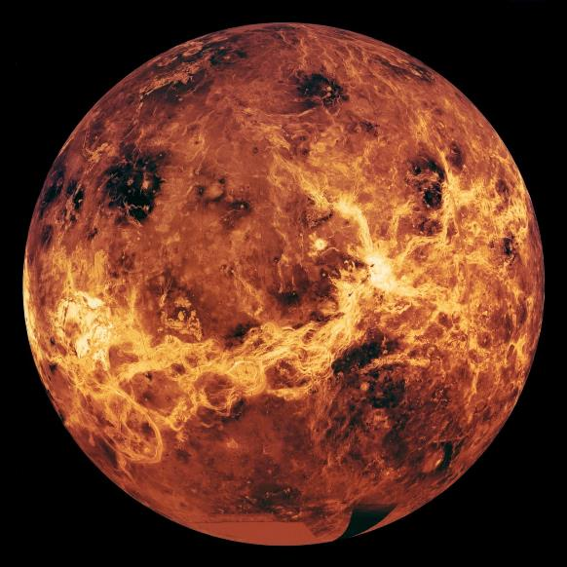
Pictures of Venus
A computer-generated image of Venus made up from data from the Magellan and Pioneer missions.
“Global view of Venus from Magellan, Pioneer, and Venera data” by NASA is licensed under CC BY 2.0

