Slide 1
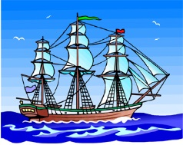
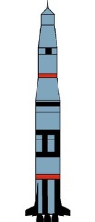
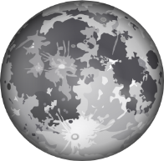

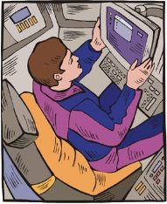



Date:
Compare Christopher Columbus’ voyage and
Neil Armstrong’s mission
Either cut out or draw a line connecting each of the pictures to the correct explorer.
Christopher Columbus
Neil Armstrong
Ship
Rocket
The Moon
Americas
Computers
Compass
Hat
Helmet
Extension: write some sentences about Christopher Columbus and Neil Armstrong and their missions
© SaveTeachersSundays.com 2013

Slide 2
Name:
Date:
Compare Christopher Columbus’ voyage and
Neil Armstrong’s mission
Christopher Columbus
Neil Armstrong
© SaveTeachersSundays.com 2013

Slide 3
Ship
Rocket
The Moon
Americas
Computers
Compass
Hat
Helmet
Ship
Rocket
The Moon
Americas
Computers
Compass
Hat
Helmet
© SaveTeachersSundays.com 2013

