Slide 1
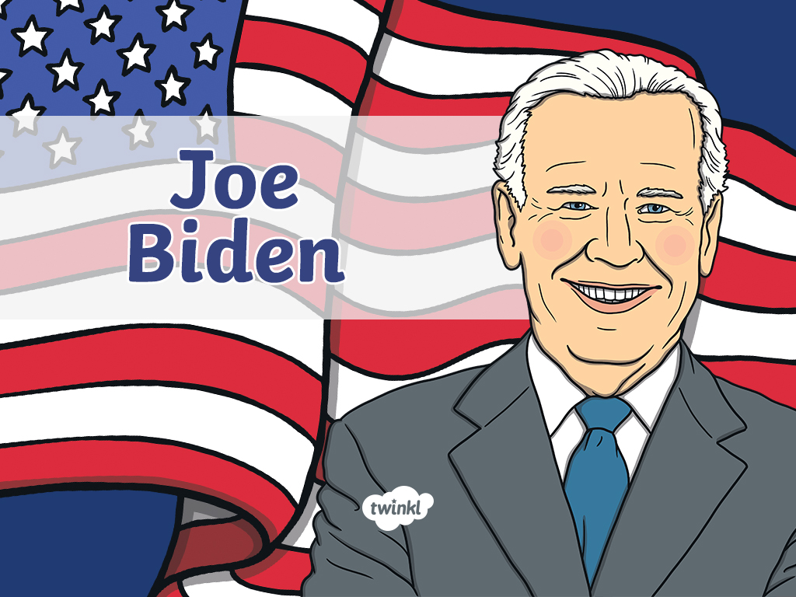

Slide 2
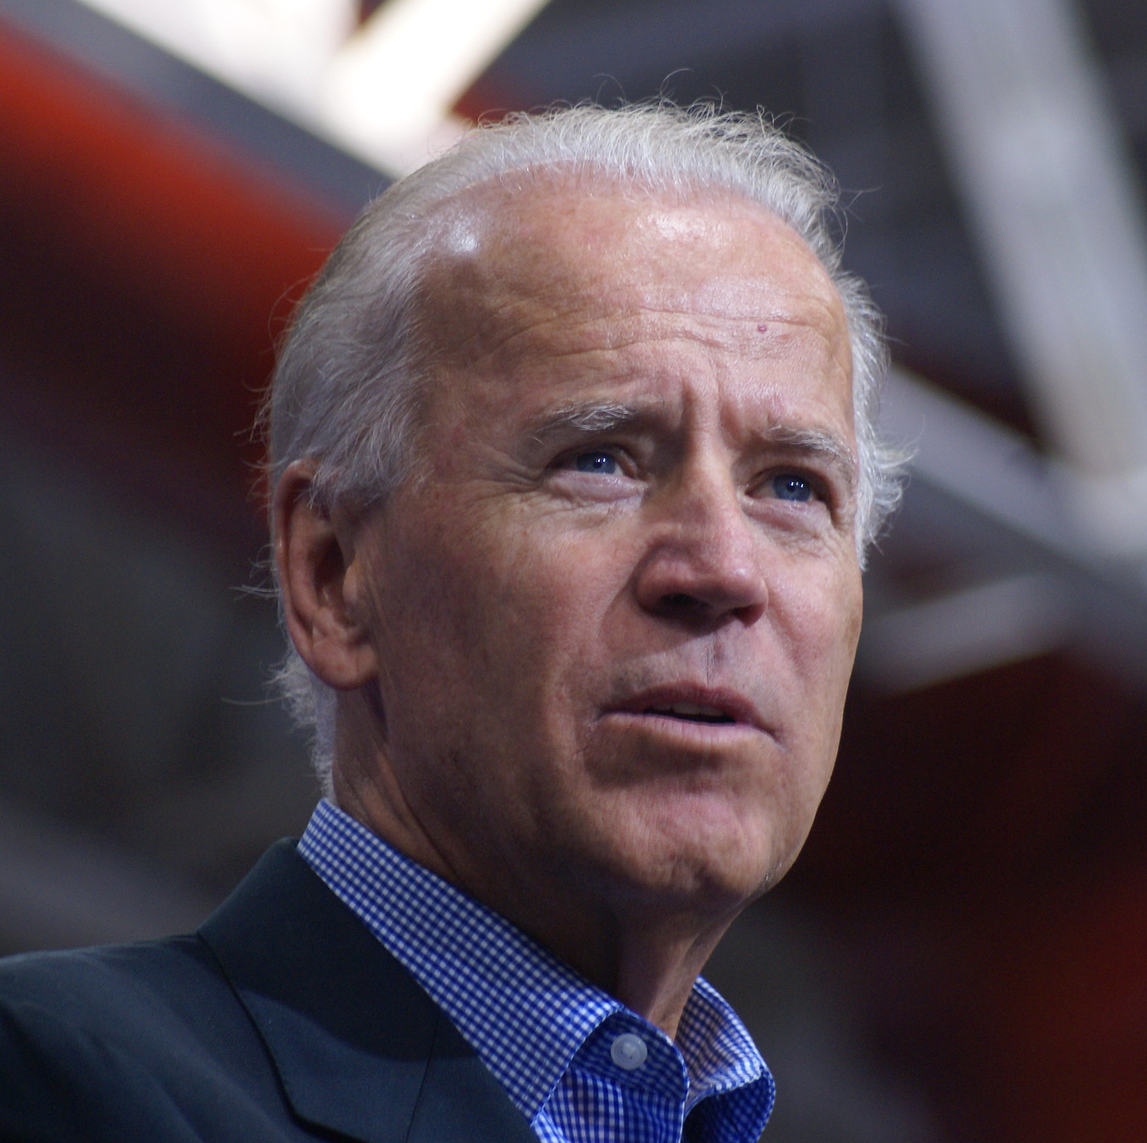
Joe Biden
Name: Joseph Robinette Biden Jr.
Date of birth: November 20, 1942

Slide 3

Childhood
Joe Biden was born in Scranton, Pennsylvania.

Slide 4
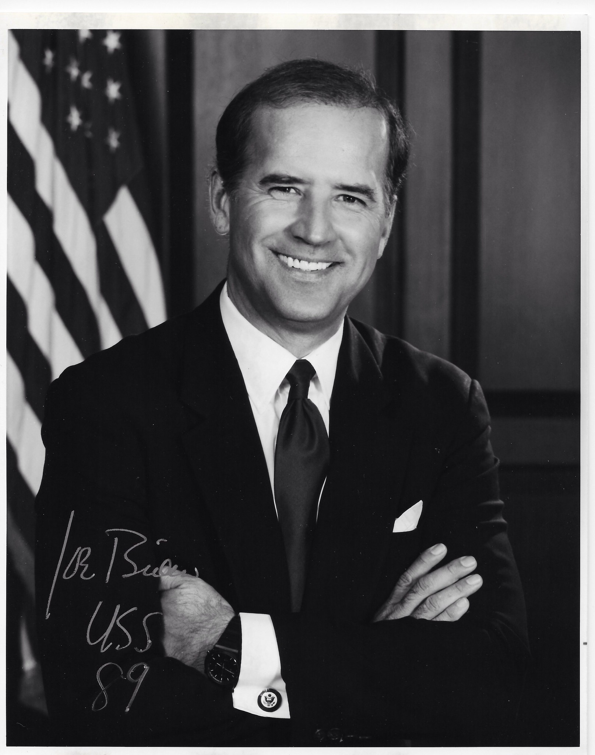
U.S. Senate 1973-2009
Joe Biden was elected to the U.S. Senate in 1973 when he was 29 years old.
He became the fifth-youngest person to be elected as a senator.

Slide 5
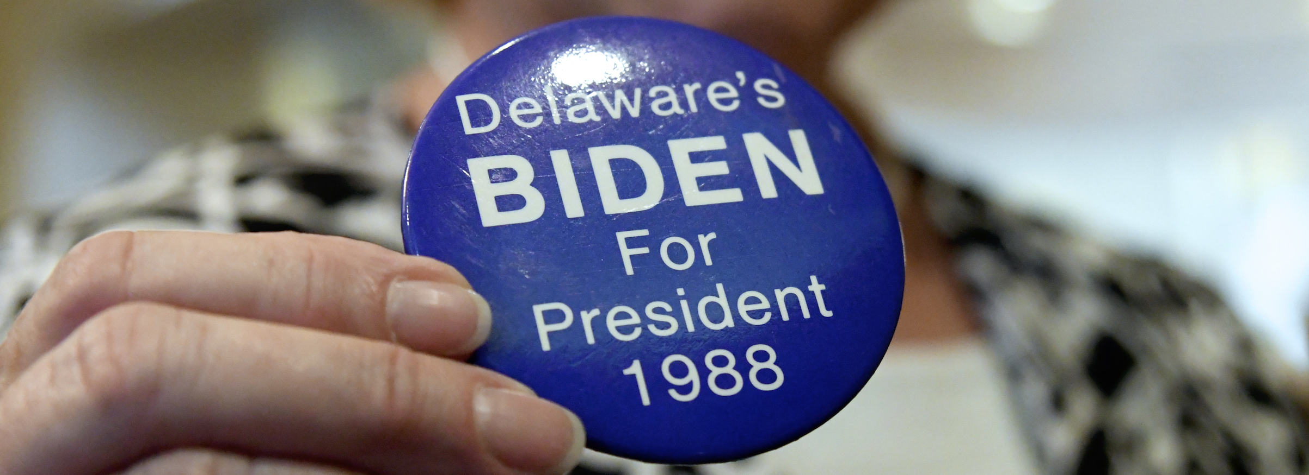
Politics
In 1988, Joe Biden ran for the Democratic presidential nomination.
He did not win the nomination that year and withdrew from the race.

Slide 6
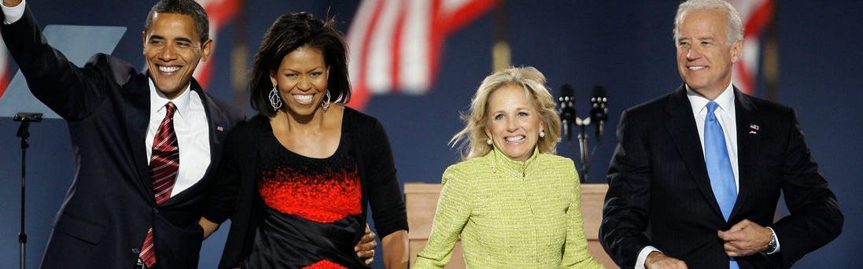
2008 Presidential Election
Joe Biden ran for the Democratic presidential nomination again in 2008. He did not win the nomination.
Barack Obama asked Biden to be his running mate as vice president. Obama and Biden won the 2008 election.

Slide 7
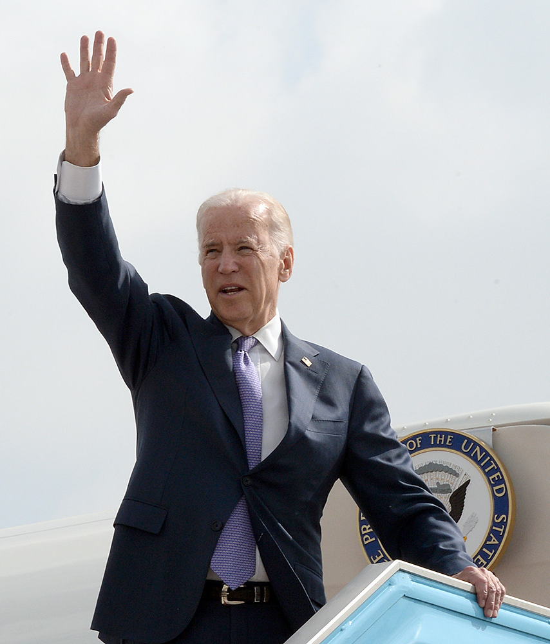
Vice Presidency
Joe Biden was the 47th vice president of the United States between 2009-2017.
He worked on foreign affairs, the financial crisis, and gun control.
Biden was a trusted adviser to President Obama.

Slide 8
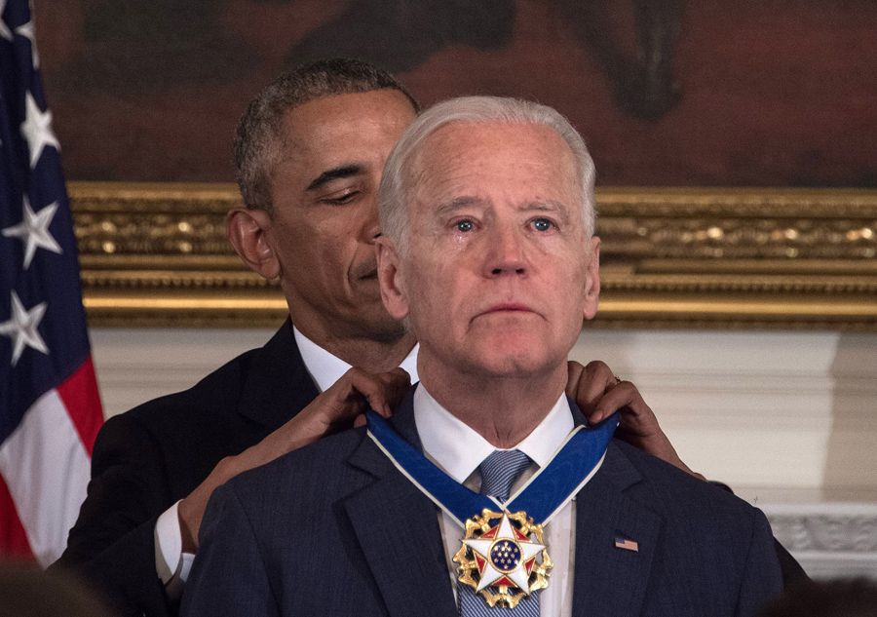
Honors
Vice President Biden was awarded the Presidential Medal of Freedom in 2017 by President Obama.

Slide 9

2020 Presidential Campaign
In 2020, Joe Biden became the Democratic Party’s presidential nominee.

Slide 10
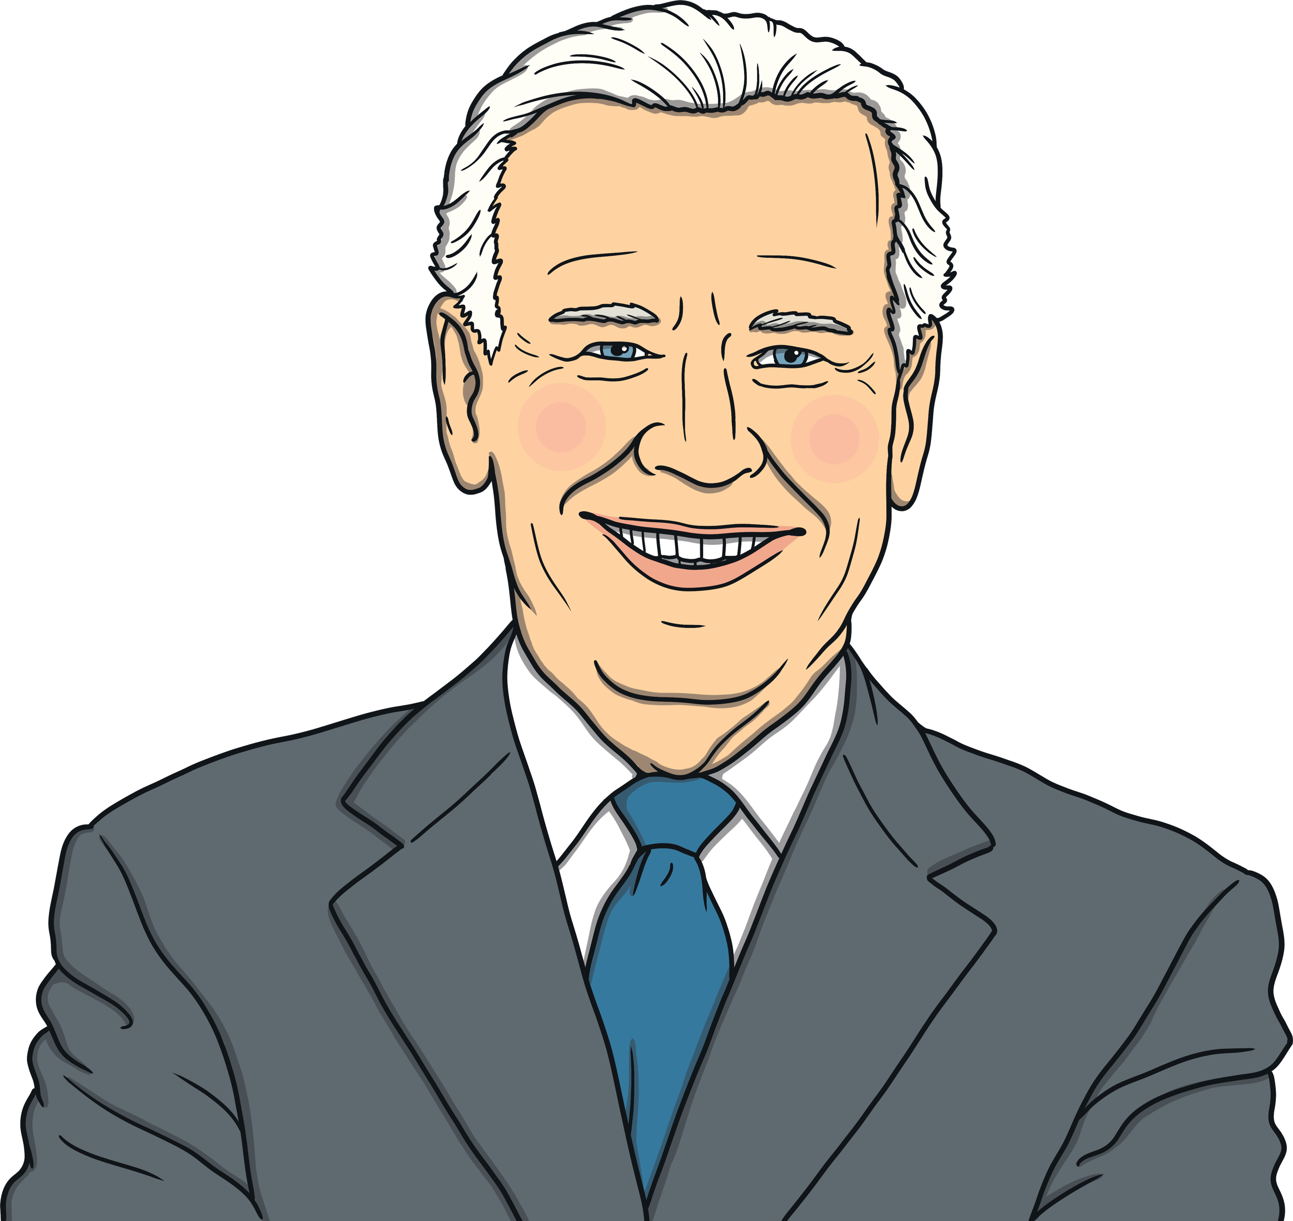
“I ask all of America to join me to compel our nation into the next phase of progress, inclusion, and opportunity for our great democracy.”
- Joe Biden

