Slide 1
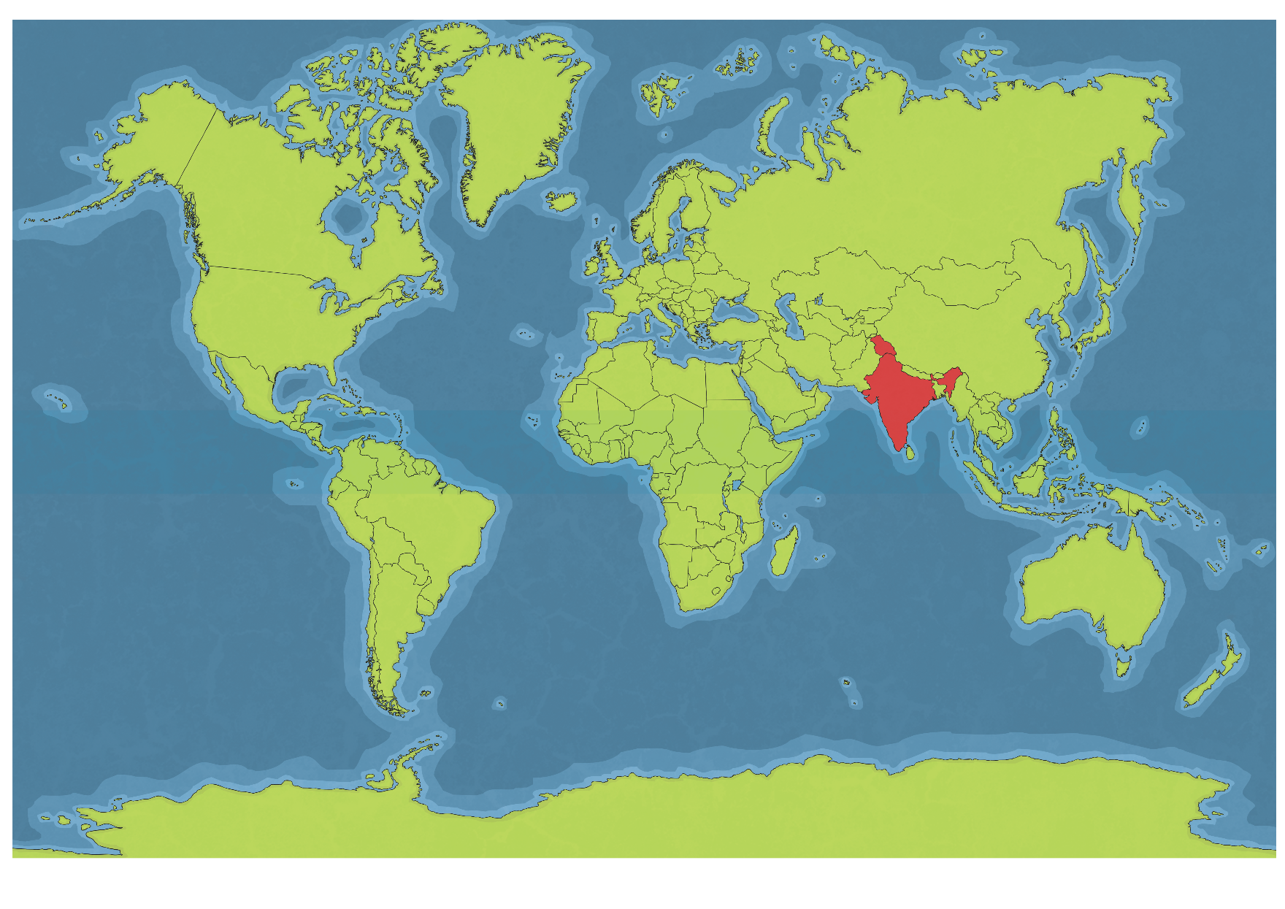
India is a country in the continent of Asia.

Slide 2
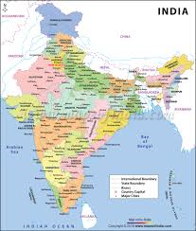
India is next to the Indian Ocean.

Slide 3
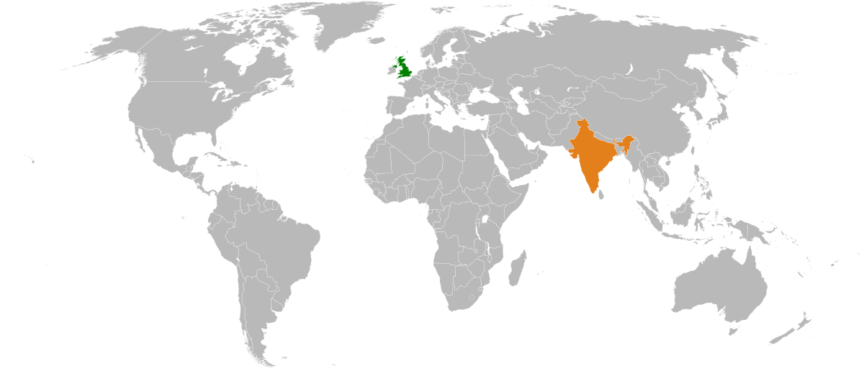
India is a long way from the UK. Can you find them both on the map?

Slide 4
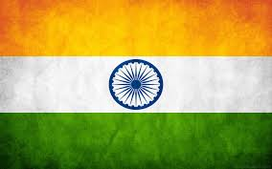
This is the Indian flag. What colours is it?

Slide 5
Tasks
Can you find India on a globe?
Can you find India on a world map and put the Indian flag on it?
Can you make your own Indian flag? You could colour it, paint it or find bits of orange and green paper, card or material to make the flag.

Slide 6
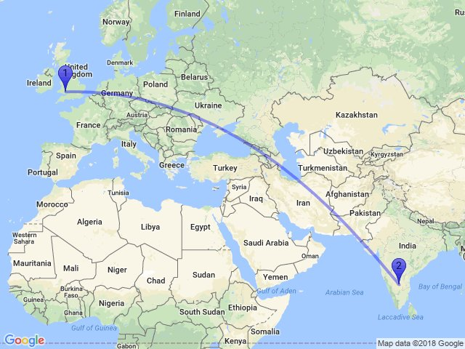
To get to India most people fly there. What vehicle would you fly there in? What countries would you fly over?

Slide 7
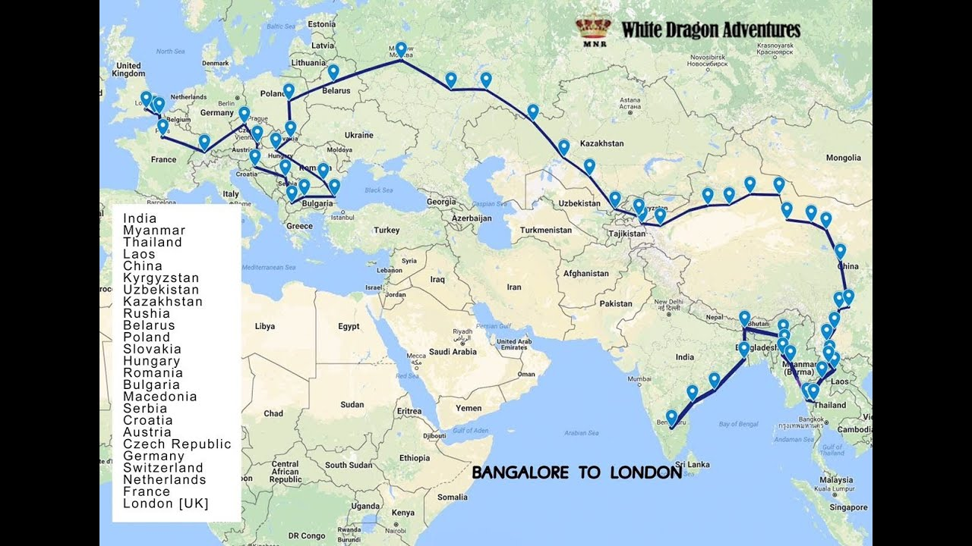
If you wanted to go by road to India, it would be a long journey. How many countries would you travel through?

Slide 8
Tasks
On your world map, can you find the UK?
Can you draw a route from the UK to India? How would you travel, would you go by plane and fly in a straight line? Would you go by car and ferry and drive across lots of different countries? Can you get to India just by boat and not going on or over any land?
Which do you think would be the quickest way to get to India?

Slide 9
What is the capital of the UK called?
Have a look on Google Earth and see what famous buildings you can find?
Can you find out what the capital of India is called?
Can you find it on Google Earth and have a look at what the buildings are like?
What are the differences between London and New Dehli

