Slide 1

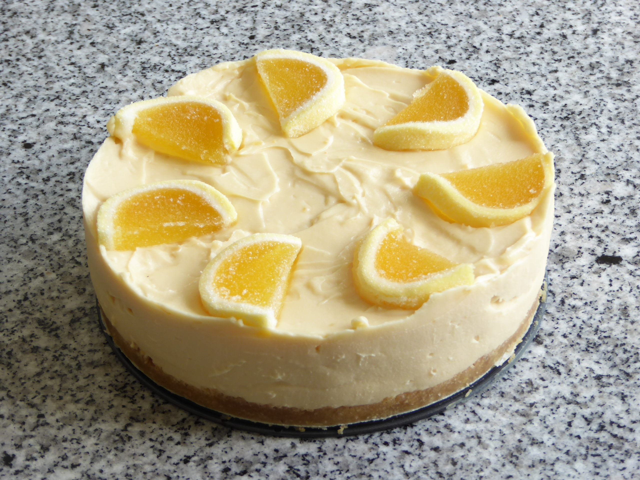
Fitzwaryn School’s
Virtual Coffee Morning Lockdown Recipe Book

Slide 2
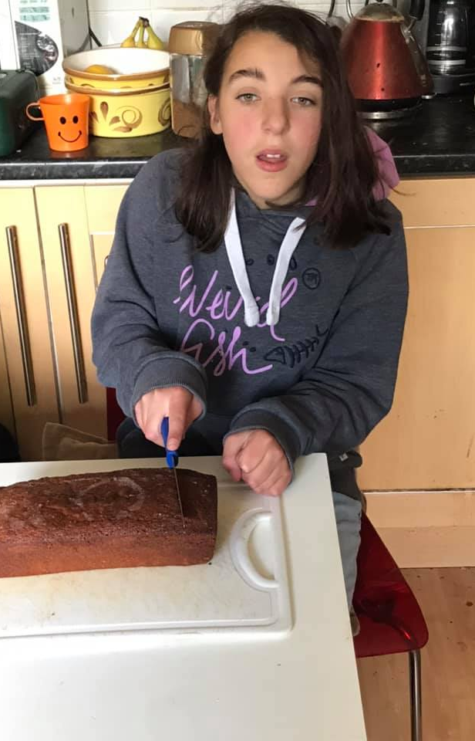
Selina’s Lemon Drizzle
Ingredients
225g/8oz unsalted butter, softened, plus extra for greasing
225g/8oz caster sugar
4 free-range eggs
225g/8oz self-raising flour
1 unwaxed lemon, zest and juice
85g/3oz icing sugar
Method
Preheat the oven to 180C/160C Fan/Gas 4. Grease a 900g/2lb loaf tin with a little butter and line with baking paper.
Tip the remaining butter and caster sugar into a food processor and blend for a few seconds. Add the eggs one at a time, blending after each addition. Add the flour and lemon zest and blend until smooth.
Pour the batter into the lined baking tin, flatten the top with the back of a spoon and bake for 50–55 minutes.
Meanwhile, stir together the lemon juice and icing sugar. When the cake has cooled a little, poke holes in the top using a skewer, chopstick or a piece of raw spaghetti. Drizzle over the icing, set aside for a few minutes, and serve.

Slide 3
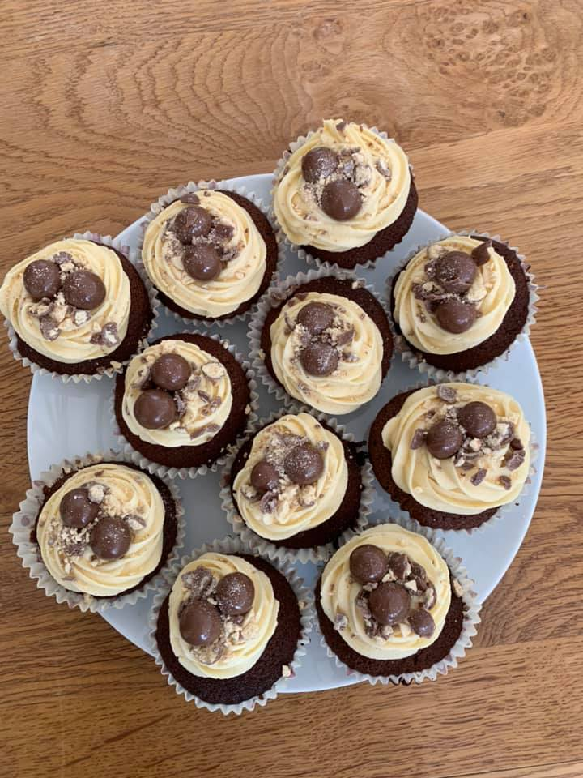
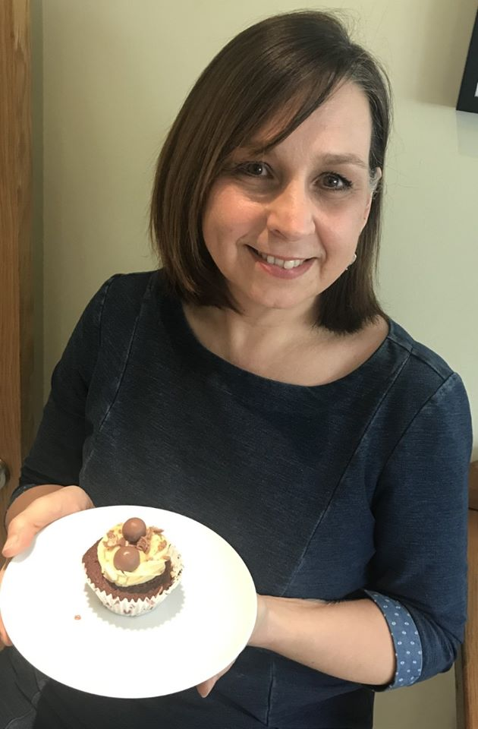
Miss Coneboy’s Malteaser Cup Cakes
Ingredients
Chocolate Malt Cupcakes
– 175g Unsalted Butter, room temperature
– 175g Light Brown Sugar
– 3 Large Eggs
– 140g Self-Raising Flour
– 15g Cocoa Powder
– 25g Malt Powder (I used Horlicks)
– 1-3tbsp Whole Milk
Malt Buttercream Frosting
– 150g Unsalted Butter, room temperature
– 375g Icing Sugar, sifted
– 25g Malt Powder (I used Horlicks)
– 1-3tbsp Whole Milk
Decorations
– Maltesers
– Crushed Maltesers
Method
To make the Cupcakes – Heat your oven to 180C/160 Fan/350F and line a cupcake/muffin tin with 12 Large cupcakes cases/Muffin Cases.
2) With a stand mixer – Beat the butter with the light brown sugar until light and fluffy – Add the eggs, self-raising flour, cocoa powder and malt powder into the mix and beat briefly until well combined. Loosen slightly with the Milk if needed!
3) Spoon the mix into the cupcake cases evenly – bake in the oven for 15-20 minutes until they’re baked through and they are springy to touch – Mine usually take 17-18 minutes, leave them to cool fully on a wire rack!
4) To make the Malt Buttercream Frosting –Beat the butter with an electric mixer for a couple of minutes to loosen it – Gradually add the icing sugar on a slow speed until it is combined then speed the mixer up and beat for 3-4 minutes until fluffy and smooth.
5) Add the malt powder, keep on beating for 5 minutes until whipped! If its really stiff, loosen with the Milk for a pipeable texture!
6) To decorate the Cupcakes – I used a Large closed star tip to decorate my cakes but you can do whatever you like! Pipe on the buttercream – Add some Maltesers, and then sprinkle on some crushed maltesers as well! Enjoy!

Slide 4
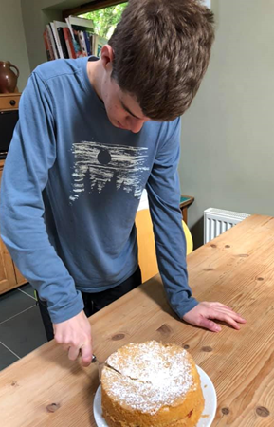
Ethan’s Sponge Cake
Ingredients
4oz (110g) self raising flour
1 teaspoon baking powder
4oz (110g) soft margarine or butter
4oz (110g) caster sugar
2 large eggs
2-3 drops of vanilla essence
To Finish- lemon curd or jam and cream (optional)
Method
Preheat oven to Gas 3 (170 c/160 fan)
Grease and line 2 sponge tins (18cm)
Sift flour and baking powder into a large bowl then add all the other ingredients and whisk until thoroughly combined (if too thick add 1-2 teaspoons of water to mix).
Divide between the 2 tins and bake in oven for 30 mins.
Cool on wire rack, then sandwich together with jam (& cream) or lemon curd.

Slide 5
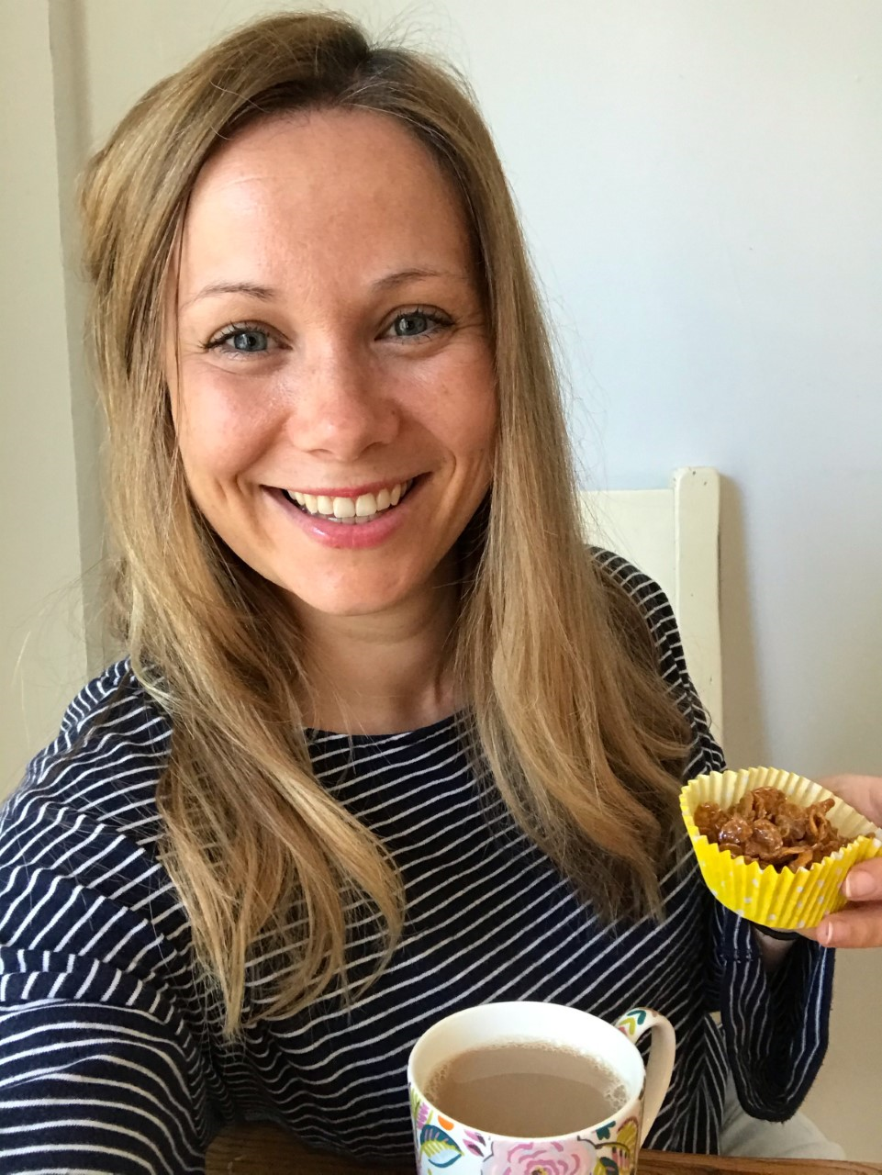
Mrs Kight’s Cornflake Cakes
Ingredients
50g Butter
100g Milk or Dark Chocolate
3 tablespoons of Golden Syrup
100g Cornflakes
Method
Melt the butter, chocolate and syrup together in a saucepan over a gentle heat
Put the cornflakes into a bowl and add the melted mixture
Stir together using a wooden spoon until cornflakes are well coated
Divide mixture between 12 cake cases and put in the fridge to cool

Slide 6
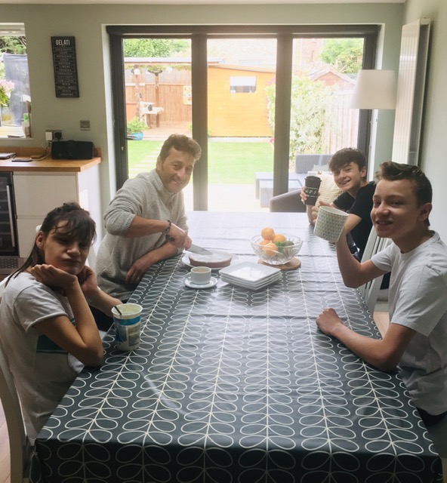
The Falino’s Banana Cake
Ingredients
2 ripe bananas
2 eggs
140g butter
140g caster sugar
140g self raising flour
1 capful vanilla essence
1/2 teaspoon mixed spice or cinnamon
Loaf tin or small round cake tin
Method
Soften butter & cream together with sugar & vanilla essence.
Add mashed bananas + 1 tbsp flour & mix well.
Add 1 egg with tbsp of flour on top of egg, mix well. REPEAT.
Add rest of flour, mix well.
Transfer to grease proof paper lined tin.
Bake at 160 for 40 minutes.

Slide 7
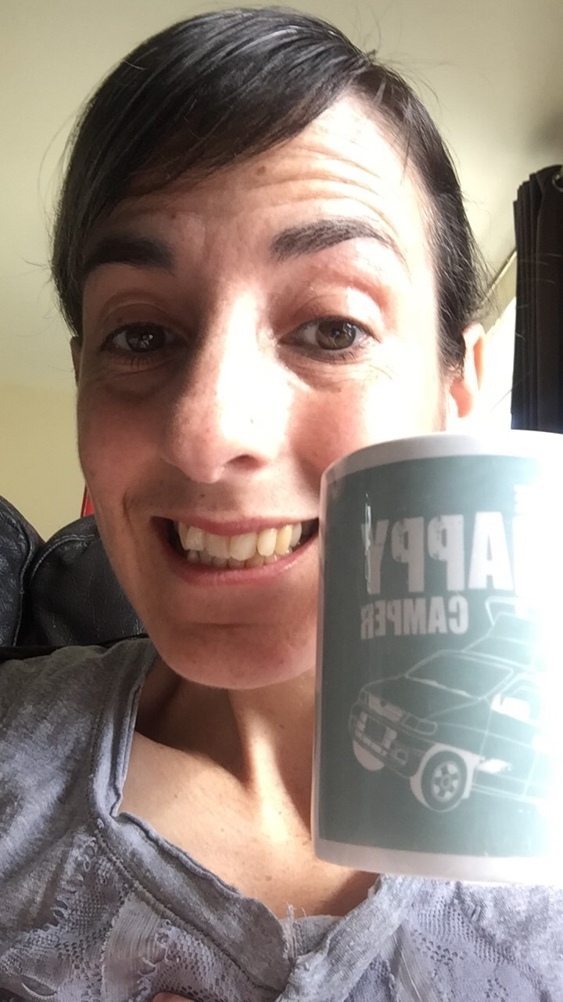
Mrs Jowett’s Gluten, Dairy & Sugar Free Carrot Cake
Ingredients -Makes 1 deep 20cm sponge
200g gluten free oat flour
3 tsp baking powder
110g dates finely chopped
50g desiccated coconut
50g nuts finely chopped or ground (we used ground almonds)
2tsp mixed spice
1tsp cinnamon
110g melted dairy free butter
110g sultanas
1 large carrot grated
Grated zest and juice of 1 orange
2 eggs beaten
For the topping
200g dairy free cream cheese
Zest and juice of 1 orange
Splash vanilla essence
Maple syrup to taste (optional)
Preheat the oven to 150c/300f/gas mark 2. Lightly grease a deep 20cm round cake tin. Sift the flour & baking powder into a large bowl and add the dates, coconut, nuts and spices. Mix thoroughly, then make a well in the centre.
Combine the melted butter, sultana, carrot, orange zest and juice. Add to the dry ingredients and combine to make a thick paste. Add the eggs and mix thoroughly.
Spoon the mixture into the cake tin and place in the oven. Bake for 45-60 minutes or until a skewer comes out clean.
Remove from the oven and allow to cool for 5-10 minutes in the tin then turn out onto a cooling rack. If using the topping, blend the ingredients until smooth and spread over the cake. Alternatively serve with mascarpone or whipped cream.

Slide 8
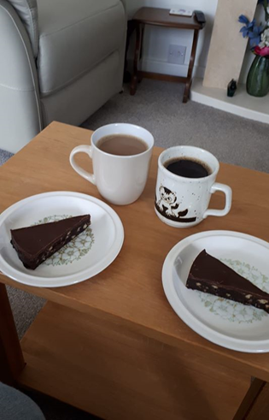
Mrs Scrimshaw’s Chocolate Fridge Cake
Ingredients
125g margarine
50g caster sugar
2 tablespoons golden syrup
2 tablespoons drinking chocolate
1 tablespoon cocoa powder
300g digestive biscuits (crushed)
50g glace cherries (chopped)
50g raisins
Icing
125g dark chocolate
15g butter
Method
Place margarine, sugar and syrup in a saucepan and heat gently until dissolved
Add drinking chocolate and cocoa and mix well
Add remaining ingredients , stir, then press into a lined cake tin
Chill in fridge
Melt butter and chocolate then spread on top of cake, chill again

Slide 9
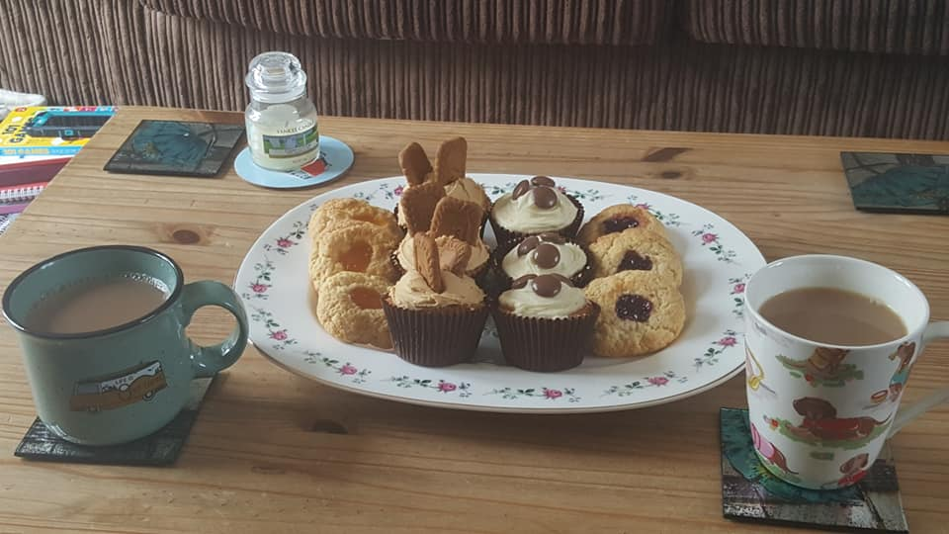
Mrs Taylor’s Fruity Buns & Cupcakes
Fruity Buns- Ingredients
225g (8oz) Self raising flour
100g (4oz) butter or margarine
100g (4oz) Caster sugar
1 egg
1 tablespoon milk
Jam (any flavour)
Method
Sieve flour into bowl, add butter (cut into cubes) and rub in until looks like bread crumbs. Stir in sugar.
In separate bowl break egg and whisk together with milk. Add into dry mix and stir together until forms a ball (add a little more milk if needed).
Turn out onto a floured surface, divide into 12 even pieces.
Squeeze each piece into a round shape and spread out onto a greased and floured baking tray.
Make a dent in each bun and fill it with jam.
Bake for 10-12 minutes at 200oC/ gas 6 (180 fan)

Slide 10
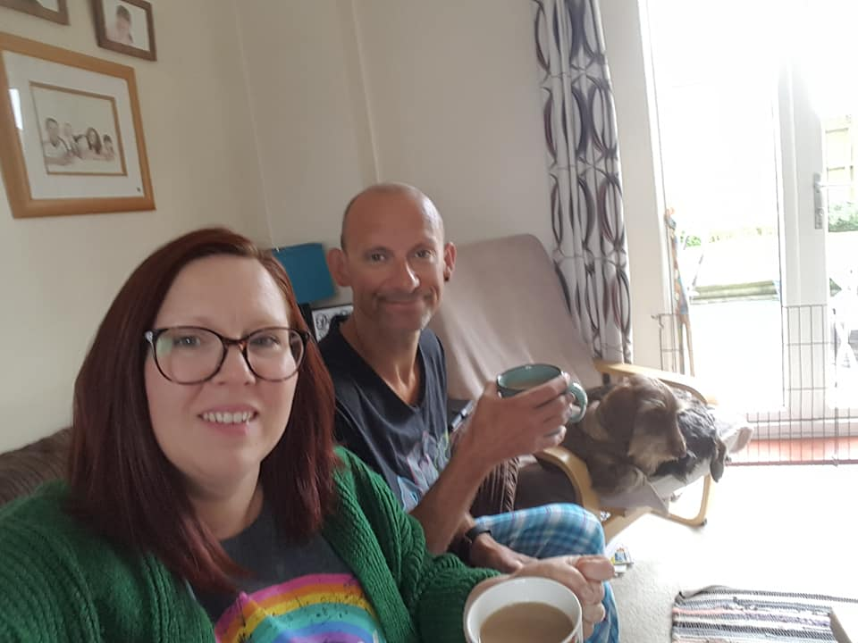
Cup cakes- Ingredients
100g (4oz) Butter
100g (4oz) Caster sugar
2 eggs
100g (4oz) self raising flour
Toppings-
Vanilla Buttercream & Galaxy Counters
Vanilla buttercream mixed with biscoff spread & topped with biscoff biscuits
(but you can top with whatever you choose!!!)
Method
Cream together butter and sugar until pale and fluffy
Add in each egg with a tablespoon of flour and mix, then gently fold in remaining flour
Divide mix into cake cases and bake for 15-20 mins
Allow to cool on a wire rack
Once cool top with buttercream (flavoured if you choose to) and your choice of toppings, the possibilities are endless!

Slide 11

Julie Mabberley’s Citrus and White Chocolate Cheesecake
Ingredients
65 g butter
150 g Fox's Crinkles Butter Biscuits (or any ginger or digestive biscuits), crushed
150 g good quality white chocolate
500 g Mascarpone cheese
1 jar lemon, orange or ginger curd (approx 300gm)
Zest of one lemon
Orange and Lemon Flavoured Jelly Slices, to decorate
Prep Time
Preparation time: 30 minutes, plus 1-2 hours chilling time
Method
1 Melt the butter in a medium saucepan and stir in the biscuits. Press into the base of a 20 cm loose -bottomed round cake tin. Chill whilst preparing the filling.
2 Place the chocolate in a bowl set over a pan of simmering water and heat gently, stirring occasionally until melted.
3 Place the Mascarpone in a bowl and mix in the curd until smooth. Mix in the melted chocolate and lemon zest. Spoon over the base and chill for 1- 2 hours.
4 Carefully remove from the tin and decorate with jelly slices. Serve in slices

Slide 12
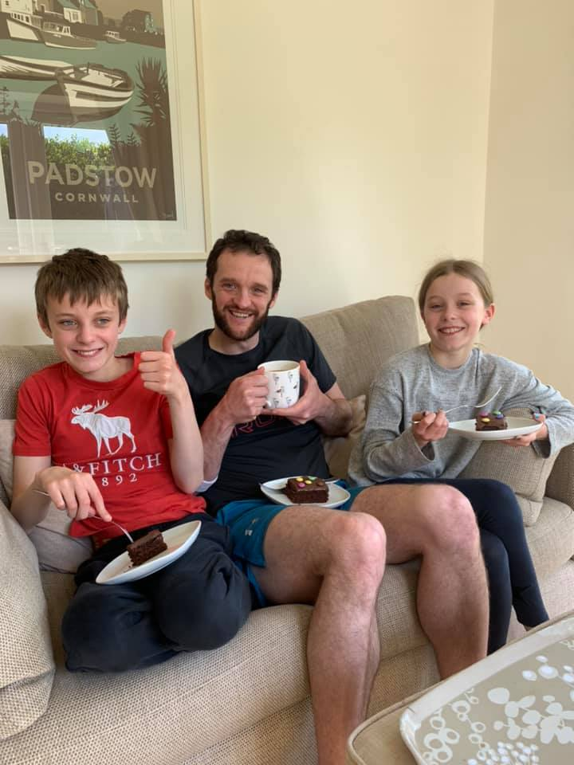
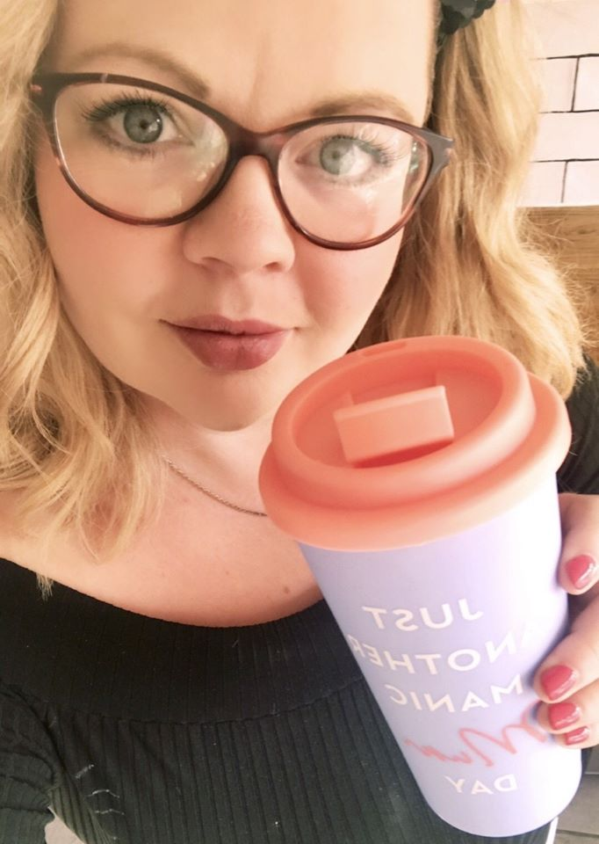
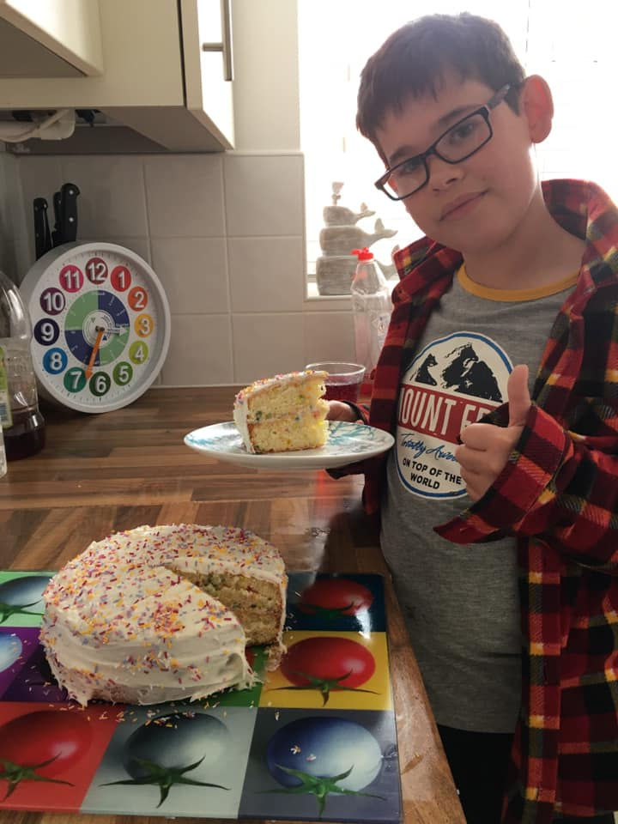
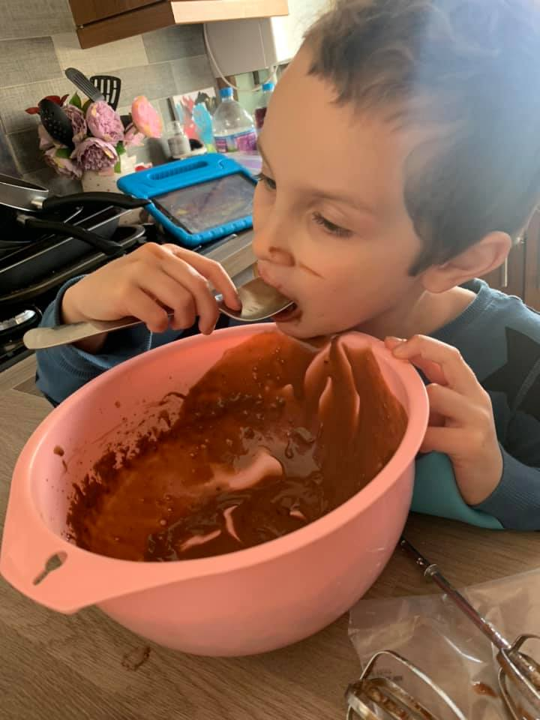
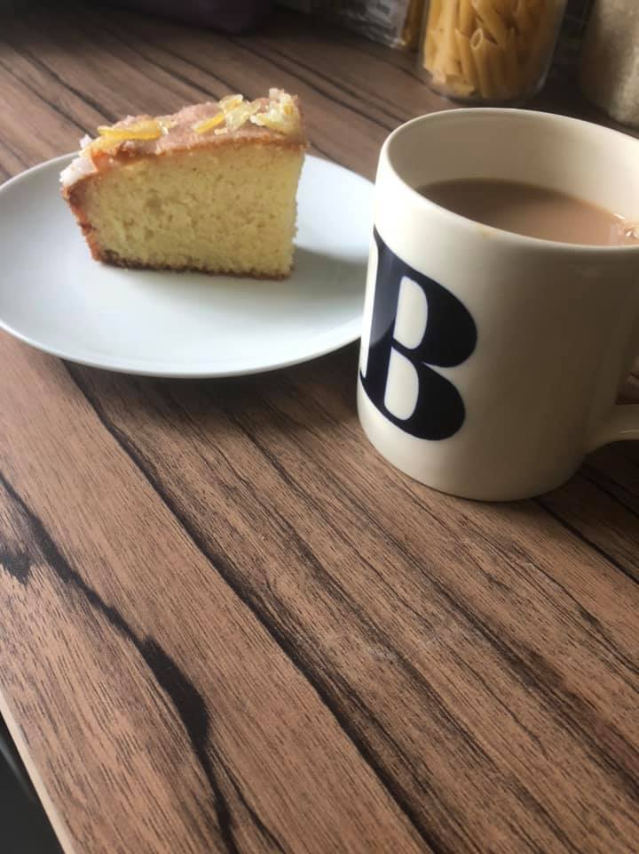
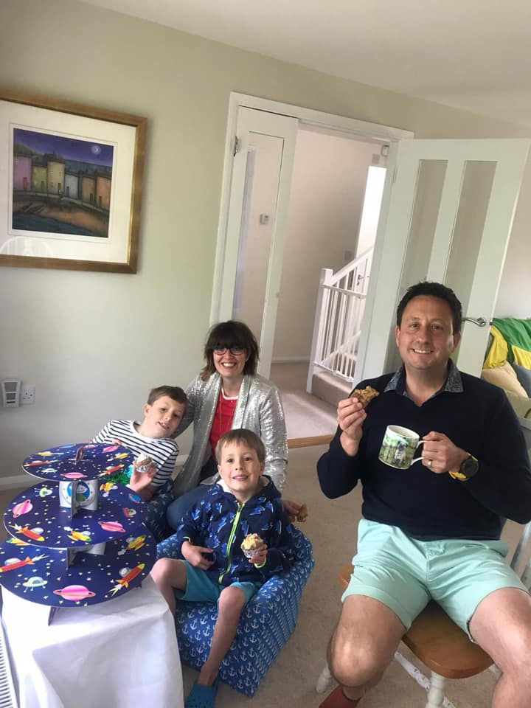
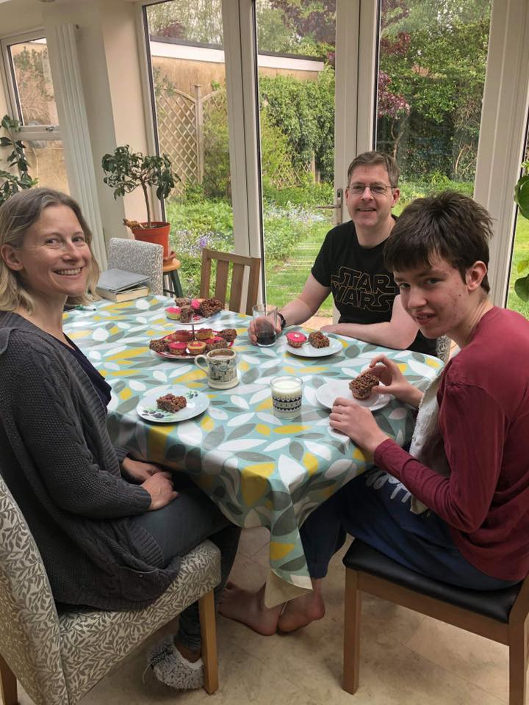
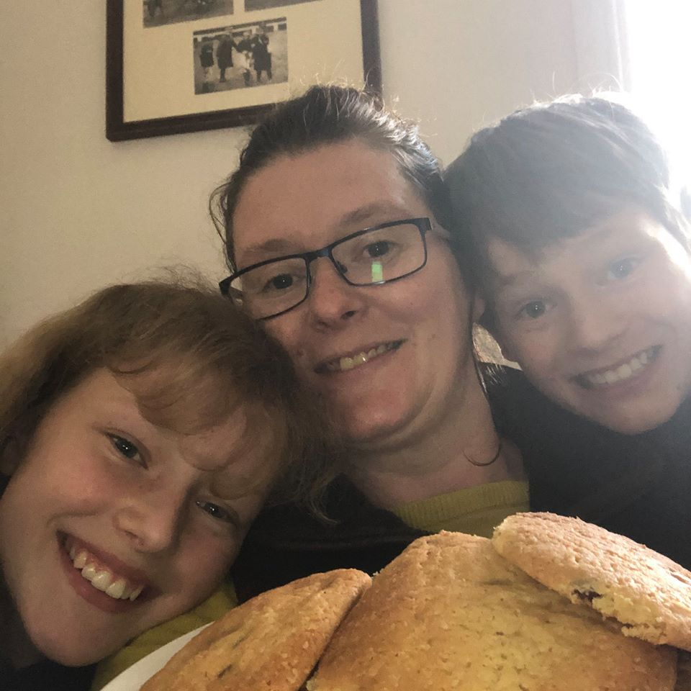
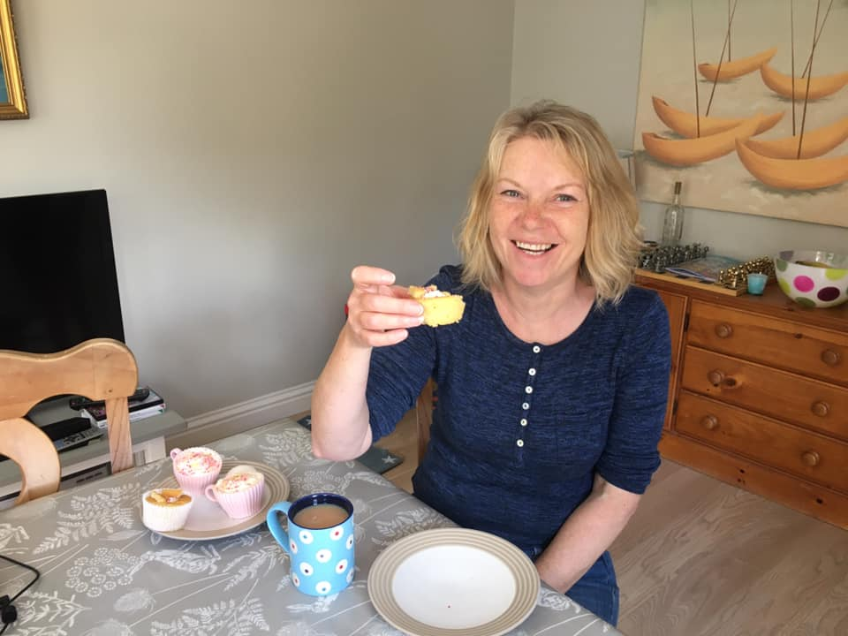
Coffee morning was enjoyed by staff and families at home and…

Slide 13
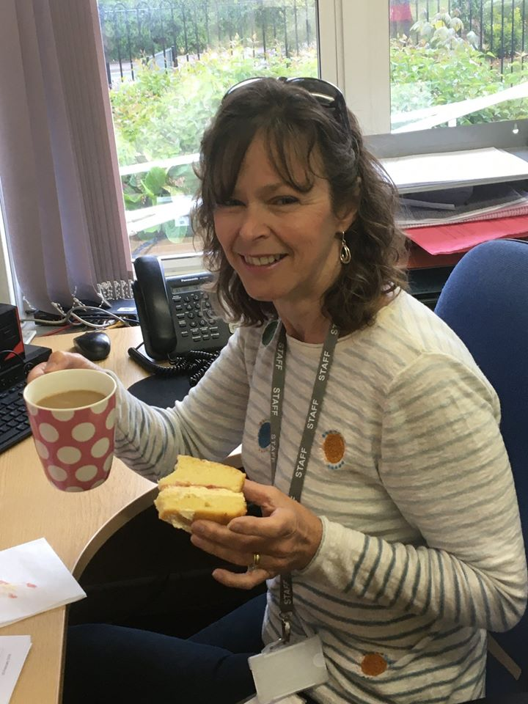
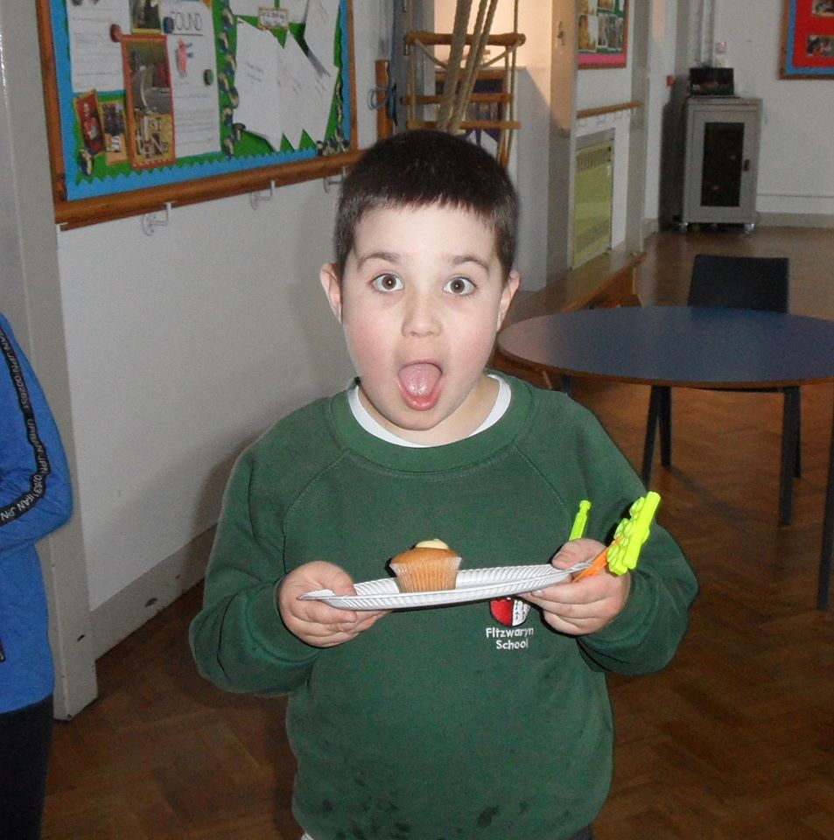
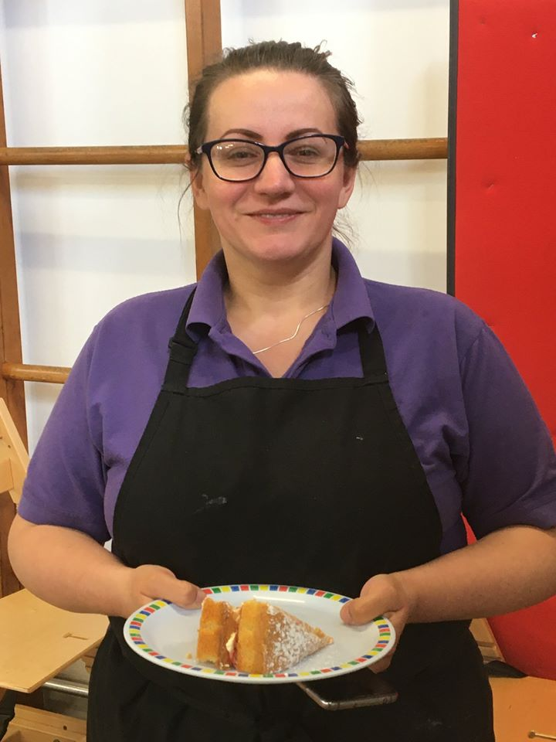
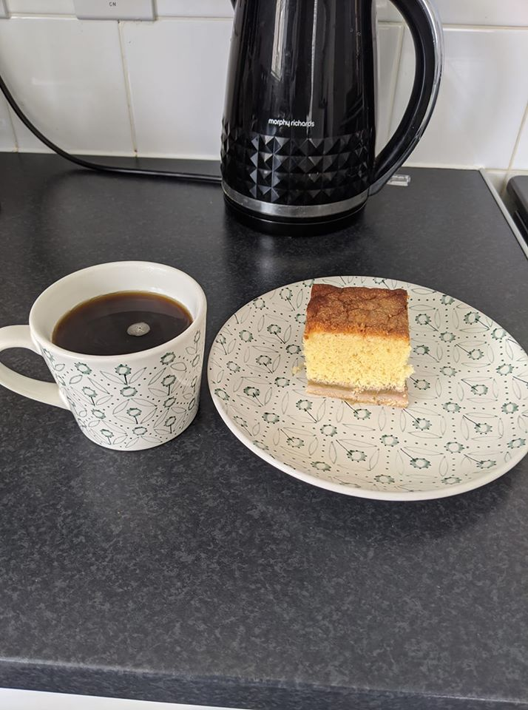
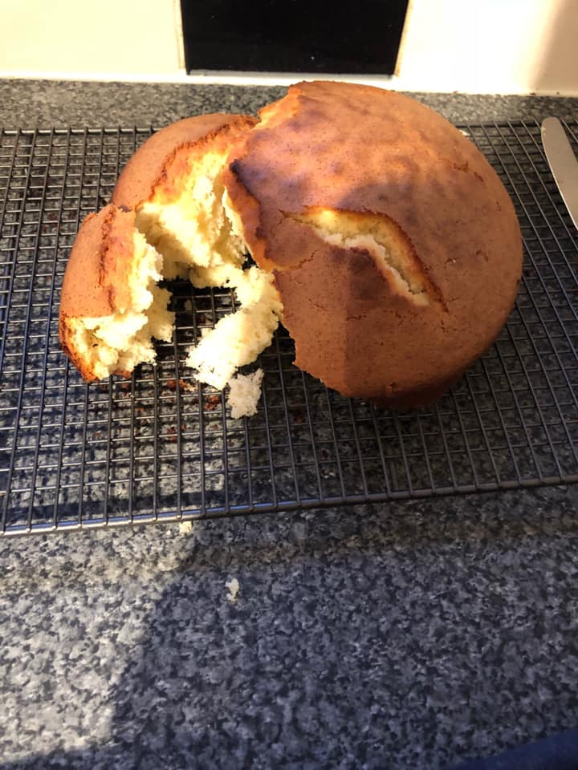
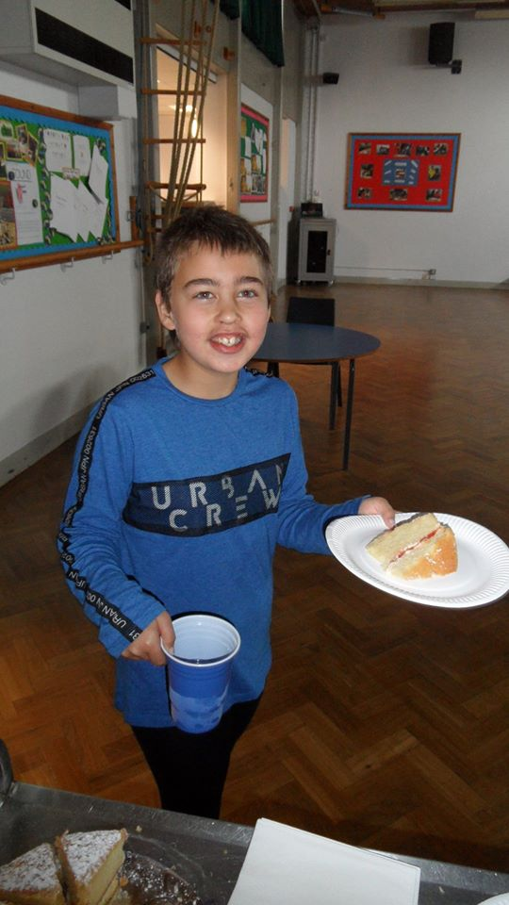
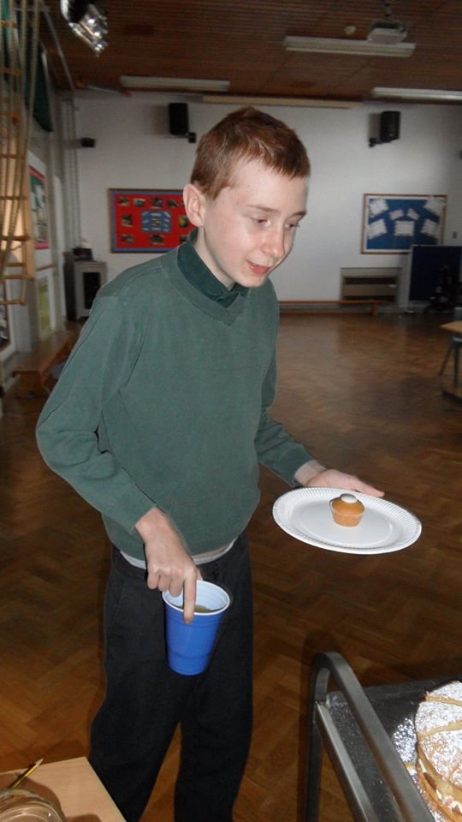
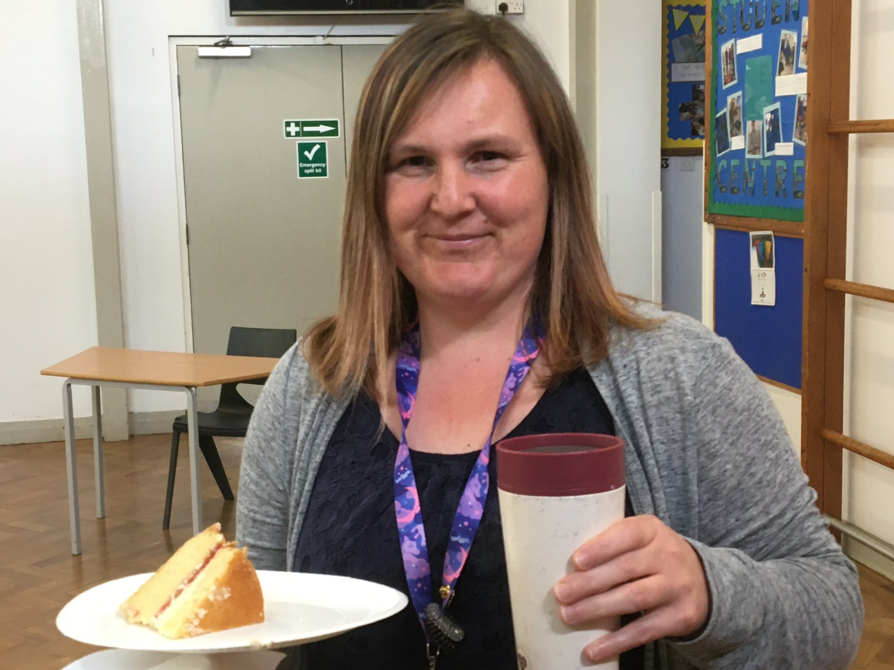
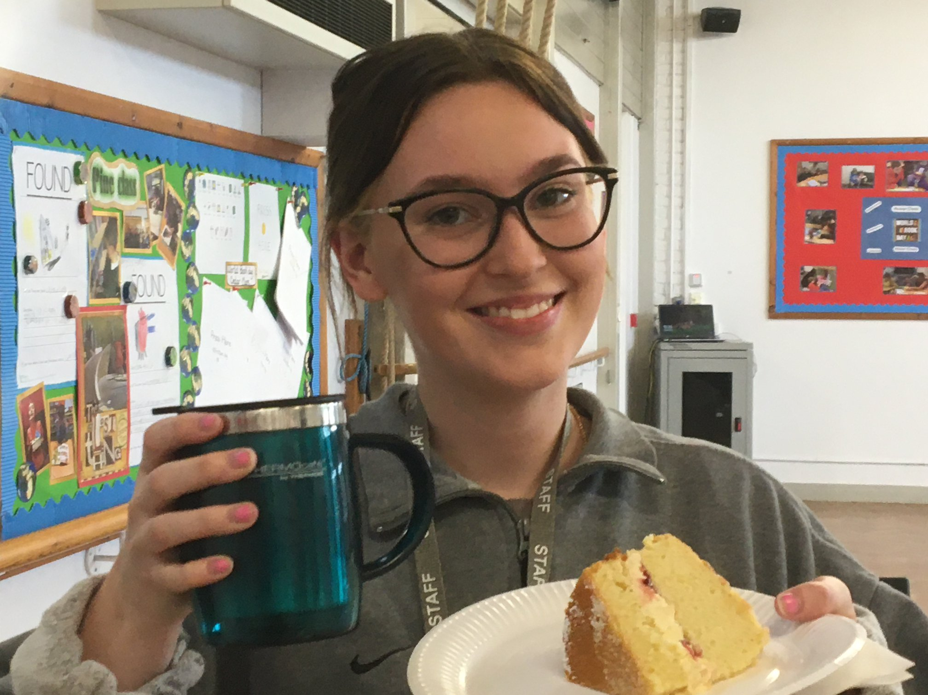
by those still
in school!

Slide 14
Bake the world a better place
Thank you for sharing in our first virtual coffee morning, now why not try someone else’s recipe!

