Slide 1
Accreditation at Fitzwaryn

Slide 2
Aims of the session
To share the KS4 Accreditation routes
To share the KS5 Accreditation routes
To explain more about Functional Skills Qualifications
To have an opportunity to ask questions

Slide 3
Ks4 Accreditation
Skills Passport – Open Awards
Personal Progress - ASDAN

Slide 4
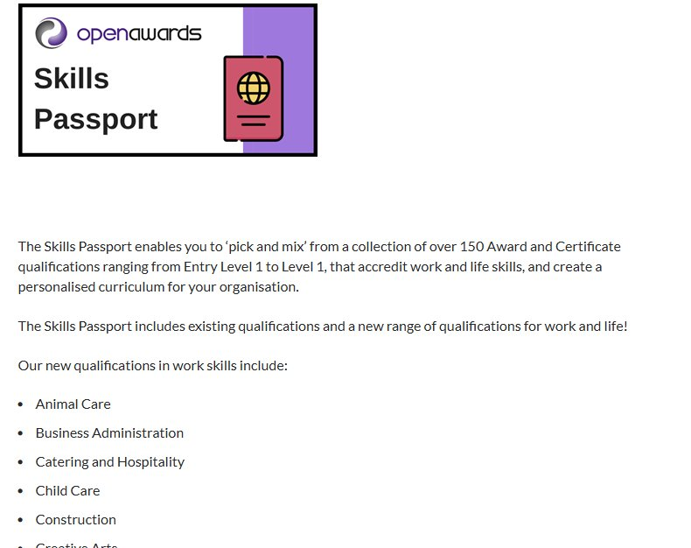
Skills Passport – Open Awards
Most pupils work towards 3 separate qualifications over a 12-month period – December- December​
This covers Years 9-10 and then Years 10-11 meaning that most pupils will achieve 6 qualifications over Key Stage 4.​
This model of delivery means that the last 6 months of Year 11 can be dedicated to Functional Skills qualifications.

Slide 5
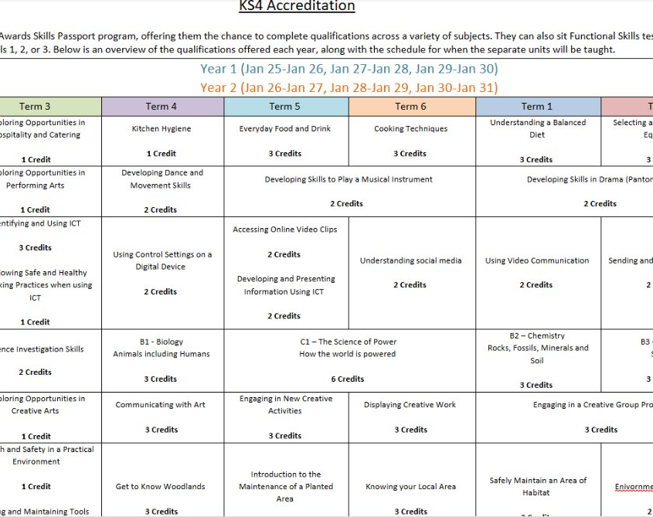
Current Courses
Hospitality and Catering Skills
IT User Skills
Performing Arts
Science
Creative Arts
Introductory Conservation Skills

Slide 6
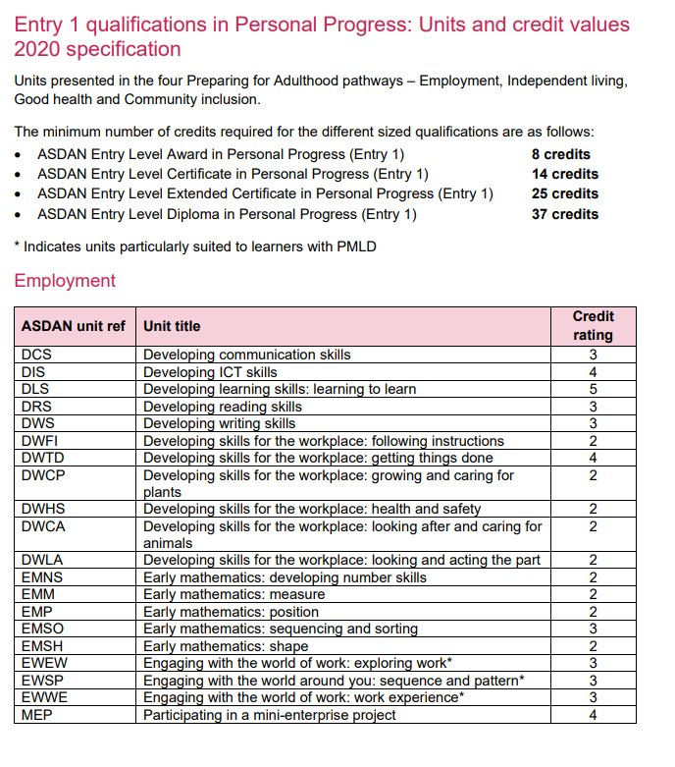
Personal Progress - ASDAN
For some of our pupils, the new Skills Passport offer didn’t align with their EHCP outcomes and learning needs.​
Decision taken this year (2024-25) to have a small cohort working towards this Entry 1 level qualification – this can then continue into post-16 provision to work towards the Diploma (37 credits)
Award | Certificate | Extended Certificate | Diploma
6 Credits | 14 Credits | 25 Credits | 37 Credits

Slide 7
Ks5 Accreditation
Award, Certificate, Extended Certificate & Diploma in Skills for Further Learning & Employment​ - Open Awards
Personal Progress – ASDAN (from September 2025)

Slide 8
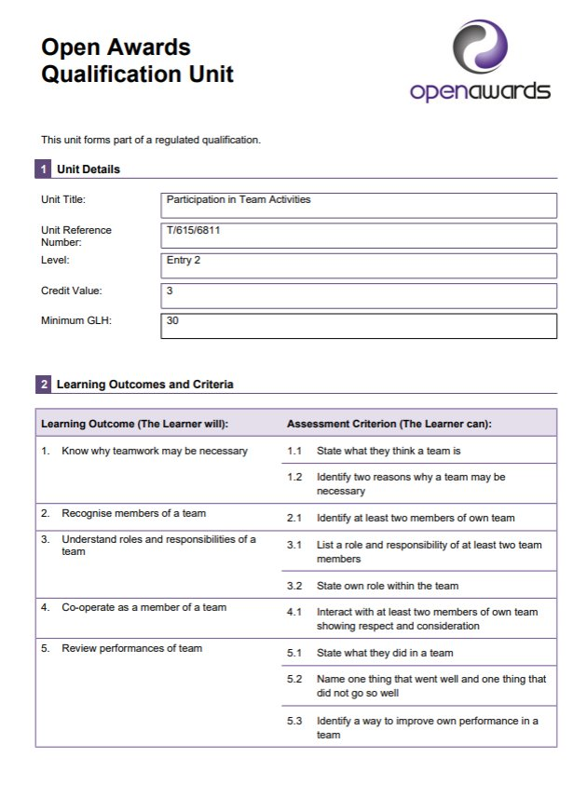
Award, Certificate, Extended Certificate & Diploma in Skills for Further Learning & Employment​ - Open Awards
The primary purpose of this qualification is to prepare students for further learning or training. This qualification offers a good starting point for their vocational education and training. It offers a mix of personal development and employability skills alongside an introduction to a range of vocational sectors.​
Again, it’s all about linking our curriculum offer to a qualification. Gaining formal accreditation for the work we are already doing (eg DofE, Enterprise, KA’s Sports, work experience)
Award | Certificate | Extended Certificate | Diploma
6 Credits | 13 Credits | 24 Credits | 37 Credits

Slide 9
Functional Skills Qualifications
Functional Skills qualifications provide reliable evidence of a learner’s achievements against demanding content that is relevant to the workplace. They provide assessment of learners’ underpinning knowledge as well as their ability to apply this in different contexts. They also provide a foundation for progression into employment or further technical education and develop skills for everyday life.
Purpose of Functional Skills English for Entry Levels: a qualification to demonstrate the ability at an appropriate level to read, write, speak, listen and communicate in English, and to apply this knowledge and these skills in familiar situations. Achievement of these qualifications can provide the basis for further study at Levels 1 and 2.​
Purpose of Functional Skills Mathematics for Entry Levels: to demonstrate a sound grasp of the underpinning skills and basics of mathematical skills appropriate to the level, and the ability to apply mathematical thinking to solve simple problems in familiar situations. Achievement of these qualifications can provide the skills for further study at Levels 1 and 2.

Slide 10
The importance of attendance
Regular attendance allows pupils to engage with all aspects of the curriculum, ensuring they meet the required learning objectives for accreditation.
Consistent attendance helps pupils develop essential skills, such as communication, independence, and practical abilities, which are often assessed in accreditation frameworks.
Many accreditation pathways require ongoing assessment, coursework, or practical evidence; missing school reduces opportunities to complete necessary tasks.
Regular attendance helps pupils develop a sense of structure, increasing their confidence in applying learned skills in assessment situations.
High attendance reflects a pupil’s engagement and commitment, which can be crucial for successfully achieving accreditation and preparing for future education or employment.
As well as being in school to complete the accreditation, it is important that your child is also on time.

