Slide 1
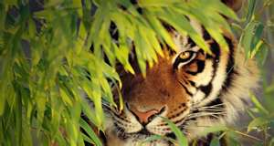
Bengal Tiger

Slide 2
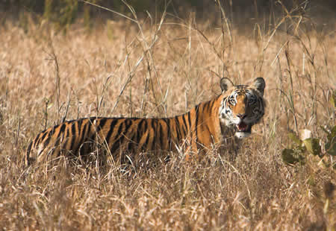
Where They Live
The scientific name for the Bengal Tiger is Panther Tigress. The Bengal Tiger is a mammal.

Slide 3
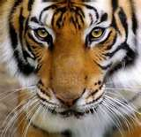
Adaptations
It needs meat, trees and leaves to survive.
The Bengal Tiger eats deer, wild pigs, water buffalo and antelope. Tigers are also known to hunt sloth bears, dogs, leopards, crocodiles and pythons as well as monkeys and hares.
As the sea level rises in areas tigers are loosing their habitat and the sea water is moving up rivers contaminating them turning fresh water into salt water.
This is forcing the tigers to move northward towards areas more heavily populated by humans and increasing the likelihood of animal/human conflicts.

Slide 4
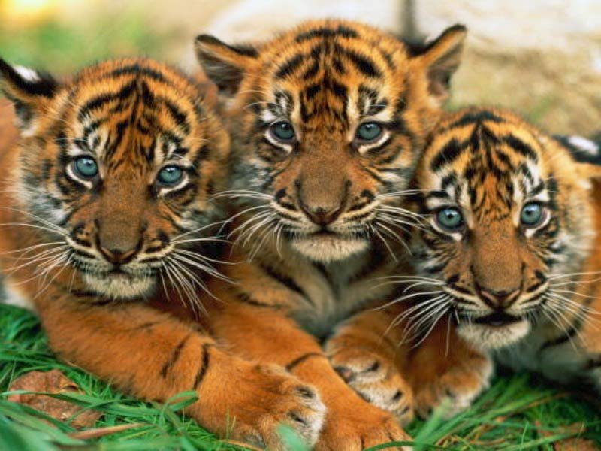
Young
The Bengal Tiger has a litter of 3-4 cubs.
Cubs follow their mother out of the den at around 8 weeks and become independent at around 18 months of age.
They leave their mothers at about 2 ½ years.

Slide 5
Status
In the early 1900s, there were around 100,000 tigers. Today, an estimated total of around 3,000-4,500 exist in the wild.
Bengal tiger: Less than 2,000
Indochinese tiger: 750-1,300
Siberian tiger: Around 450
Sumatran tiger: 400-500
Malayan tiger: 600-800
South Chinese tiger: Extinct in the wild
Caspian tiger: Extinct
Javan tiger: Extinct
Bali tiger: Extinct
There were once nine subspecies of tigers: Bengal, Siberian, Indochinese, South Chinese, Sumatran, Malayan, Caspian, Javan and Bali. The Caspian, Javan and Bali are extinct, and the rest are endangered.

Slide 6
Interesting Facts
The tiger is the largest member of the (cat) family. It weights about 400 to 675 pounds.
Just like the housecat, tigers keep their claws sharp for hunting by pulling in their retractable claws into a protective sheath.
The Bengal Tiger is 3/3 ½ feet tall and 4.6 to 9.2 feet long.
Females are smaller than males.
Bengal Tigers live about 10 to 15 years.

