Slide 2


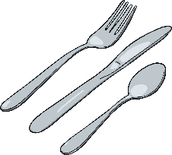
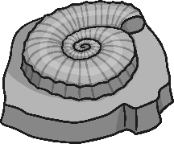


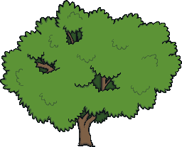

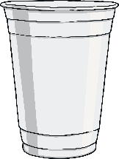

Different Objects
Look at all these objects.
Talk about
It!
How could you sort them into different groups?

Slide 3
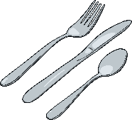








Grouping Things
Look at the way the things have been grouped.
Talk about
It!
Can you work out what each group is?
Things That Are Alive
Things That Were Once Alive
Things That Have
Never Been Alive

Slide 4

How Do We Know If Something Is Alive?
Talk about
It!
What do living things do?
There are certain things all living things do:
move – think about how a flower will open up towards sunlight
make more of their own type – humans and other animals have babies, birds will lay eggs
respond to the place they are in – if a plant is in a dark place, it will try to grow towards the light
feed – animals will eat food, plants will suck up goodness from soil
grow
get rid of waste – like when humans go to the toilet
need oxygen

Slide 5


Is It Alive?
Talk about
It!
What living things can you think of?
Remember, they need do be able to do all seven things.
Fossils are the remains of animals that lived a long time ago.
Other things have never been alive. We know they have never been alive because they aren’t made from something that could do all of the seven things.
There are some things that used to be alive but aren’t any more. Paper is made from wood, which comes from trees which were once alive.

Slide 6


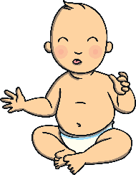
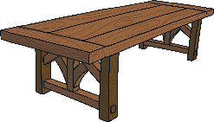
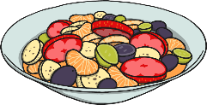

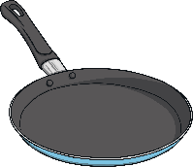

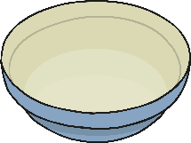
Living, Dead or Never Alive?
Decide whether each thing is living, dead or has never been alive. Then, click to see if you were right.

Slide 7





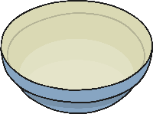

Living, Dead or Never Alive?
Living
Dead
Never Alive

