Slide 1

Phonics Wednesday’s Lesson
Phase 3

Slide 2
Learning intention:
-I can read the words with the ‘ear’ sound.
Success criteria
-pupils will be able to listen to sounds in words.
-pupils will be able to read words containing the triagraph ‘ear’.

Slide 3
Can you read these tricky words?
to
no
the
I
go
me
we
be
she

Slide 4
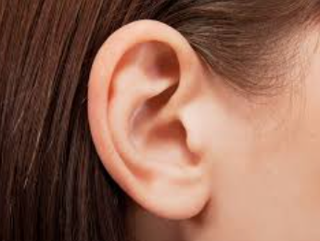
ear

Slide 5
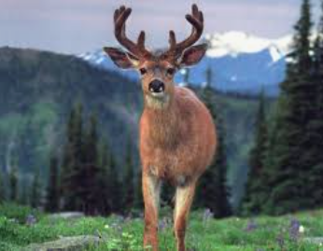
d | ear

Slide 6

h | ear

Slide 7

f | ear

Slide 8

g | ear

Slide 9
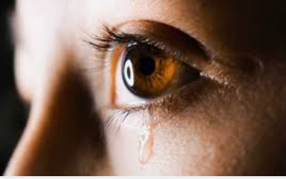
t | ear

