Slide 1
Place Value
Counting and estimation
Objectives
Lesson 1
Count, read and write numbers to 20 in numerals.
Identify and place 2-digit numbers on a number line. Compare and order numbers to 100.
Lesson 2
Make reliable estimates of numbers up to 20.
Count in 10s from 1-digit and 2-digit numbers.
Extension:
Order and compare numbers to 20 using a line.
Make reliable estimates of numbers up to 100.
Notes:
Before teaching, be aware that:
On Day 1 children will need a bead string each. You will need a washing line with numbers 1-20.
On Day 2 you will need 100 bead bar, interesting items in a box.
On Day 3 you will need Teddy, 20 bead bar, shopping vouchers.

Slide 2
Place Value
Counting and estimation
Objectives
Monday’s Maths Lesson
Count, read and write numbers to 20 in numerals.
Identify and place 2-digit numbers on a number line.

Slide 3

Place Value
Counting and estimation
Starter:
Short Mental Workout
Let's Get Fit | Count to 100 | Count to 100 Song | Counting to 100 | Jack Hartmann - YouTube
Notes:
You can choose to drag this slide to the start of Day 2
Show children the 100-bead bar with tags showing multiples of 10. Point to a multiple of 10, e.g. 40. What number comes before 40? After 40? Repeat with 20 and 60. Show 45 beads and write 45 on the board. What is one more than 45? Write 46 after 45. What is the number before 45? One less than 45? Write 44 before 45. Repeat with 36.

Slide 4


Monday’s Lesson: Count, read and write numbers to 20 in numerals. Identify and place 2-digit numbers on a number line.
1
2
3
4
5
6
7
8
9
10
11
12
13
14
15
16
17
18
19
20
Point to and say the numbers in order from 1 to 20.
Notes:
Teaching with Y1 and Y2
Say the numbers from 1 to 20 in order, pointing to numbers on the washing line as you do so.

Slide 5


Monday’s Lesson: Count, read and write numbers to 20 in numerals. Identify and place 2-digit numbers on a number line.
2
3
5
6
13
8
9
10
11
12
13
14
15
17
18
19
20
1
4
7
7
16
Close your eyes while I swap two cards...
How can you tell?
Which numbers did I move?

Slide 6
Monday’s Lesson: Count, read and write numbers to 20 in numerals. Identify and place 2-digit numbers on a number line.
3
6
12
10
12
13
14
15
17
18
19
20
1
2
4
5
7
8
9
11
9
16
Which numbers did I move this time?
Close your eyes while I swap two other cards...
How can you tell?

Slide 7
Monday’s Lesson: Count, read and write numbers to 20 in numerals. Identify and place 2-digit numbers on a number line.
1
2
3
4
5
6
7
8
9
10
11
12
13
14
15
16
17
18
19
20
Can you describe where the numbers should go?
Oh no – lots of numbers have come off the line!
Close your eyes again...
Notes:
Quickly count from 1 to 20 in order, pointing to numbers on the washing line as you do so. Remove all cards except 1, 5, 10, 15 and 20, but not pegs. Shuffle removed cards, take one at a time and ask children to describe (not point) where to place them on the line.
Y1 Children can now go on to do differentiated GROUP ACTIVITIES. You can find Hamilton’s group activities in this unit’s TEACHING AND GROUP ACTIVITIES download.
WT/ARE: Make cube snakes to match numeral amounts and compare.
GD: Make cube snakes to match numeral amounts; order three numbers.

Slide 8
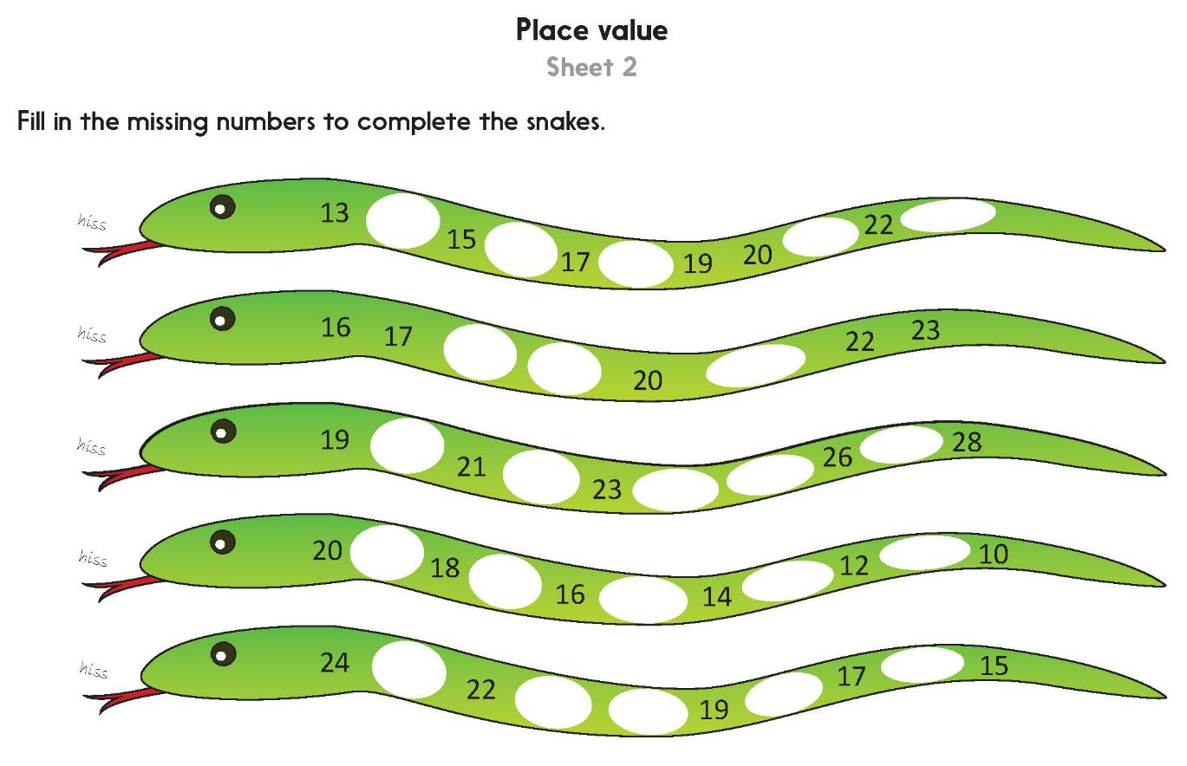
Notes:
The Practice Sheet on this slide is suitable for most Y1 children.
Differentiated PRACTICE WORKSHEETS are available on Hamilton’s website in this unit’s PROCEDURAL FLUENCY box.
WT: Place value Sheet 1
ARE/GD: Place value Sheet 2

Slide 9
Place Value
Counting and estimation
Objectives
Wednesday’s Lesson
Make reliable estimates of numbers up to 20.
Count in 10s from 1-digit and 2-digit numbers.

Slide 10
Place Value
Counting and estimation
Starter:
Short Mental Workout
Let's Get Fit | Count to 100 | Count to 100 Song | Counting to 100 | Jack Hartmann - YouTube
Notes:
You can choose to drag this slide to the start of Day 2
Show children the 100-bead bar with tags showing multiples of 10. Point to a multiple of 10, e.g. 40. What number comes before 40? After 40? Repeat with 20 and 60. Show 45 beads and write 45 on the board. What is one more than 45? Write 46 after 45. What is the number before 45? One less than 45? Write 44 before 45. Repeat with 36.

Slide 11
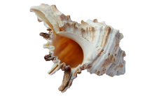
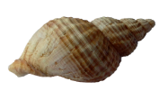
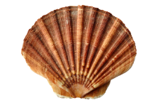
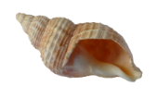
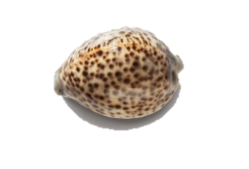
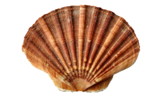
Wednesday’s Lesson: Make reliable estimates of numbers up to 20.
Show children a box of objects...
How many are there?
Are there more than 5?
Are there more than 10?
Notes:
Further teaching with Y1

Slide 12
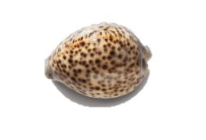
Wednesday’s Lesson: Make reliable estimates of numbers up to 20.
Let’s count them like this!
There are 15 shells!
Notes:
Tip the objects out and count them, pointing to each item as you do so. Discuss how it is difficult to keep track. Move them into a line and re-count from the children’s left to right.
Point out that there is the same number even though they are rearranged.

Slide 13
Wednesday’s Lesson: Make reliable estimates of numbers up to 20.
Show children a box with a different number of objects.
Are there more or less this time?
Are there more than 5?
Are there more than 10?
Notes:
Ask children if there be the same number if you rearrange them in a line.

Slide 14
Wednesday’s Lesson: Make reliable estimates of numbers up to 20.
Let’s count them like this!
There are 13 shells!
Notes:
Repeat with a different number of items (between 10 and 20), asking if children think there are more or less than the previous amount.
Y1 Children can now go on to do differentiated GROUP ACTIVITIES. You can find Hamilton’s group activities in this unit’s TEACHING AND GROUP ACTIVITIES download.
WT: Estimate up to 20 toys in different boxes; arrange and count.
ARE/GD: Estimate up to 20 objects in pots; arrange and count.

Slide 15
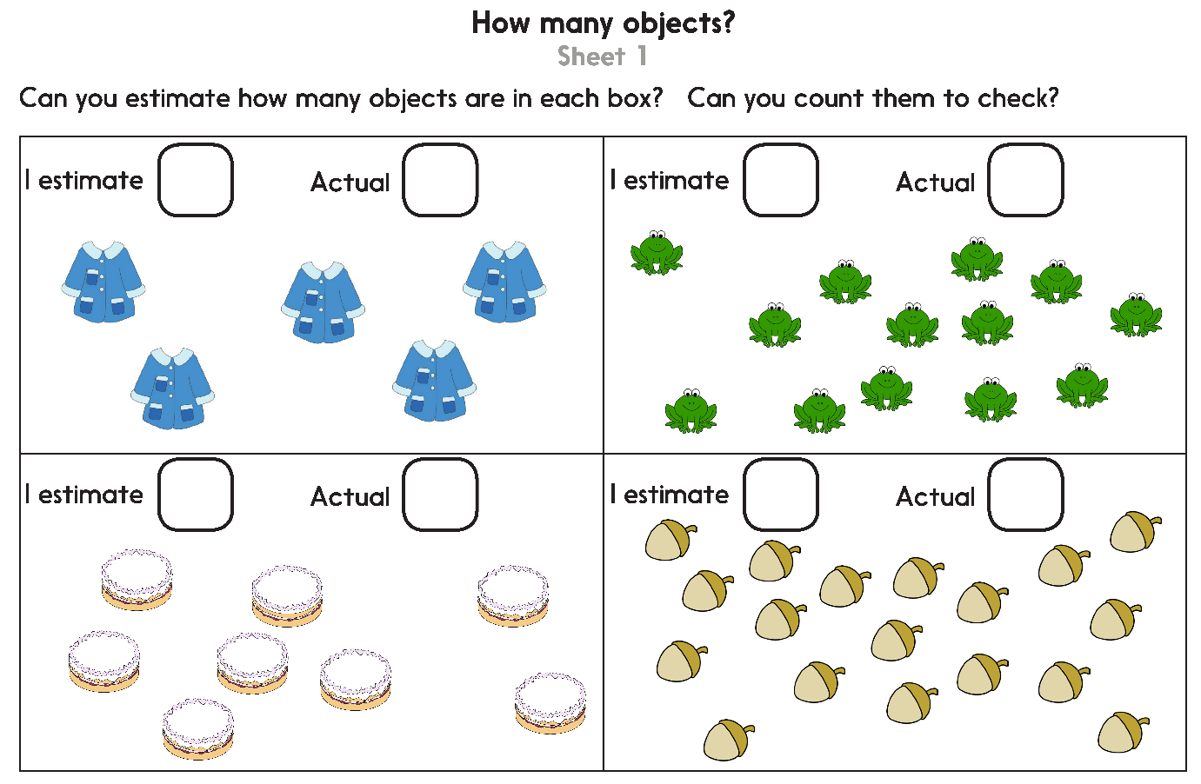
Notes:
The Practice Sheet on this slide is suitable for most Y1 children.
Differentiated PRACTICE WORKSHEETS are available on Hamilton’s website in this unit’s PROCEDURAL FLUENCY box.
WT/ARE: How many objects? Sheet 1
GD: How many objects? Sheet 2

Slide 16
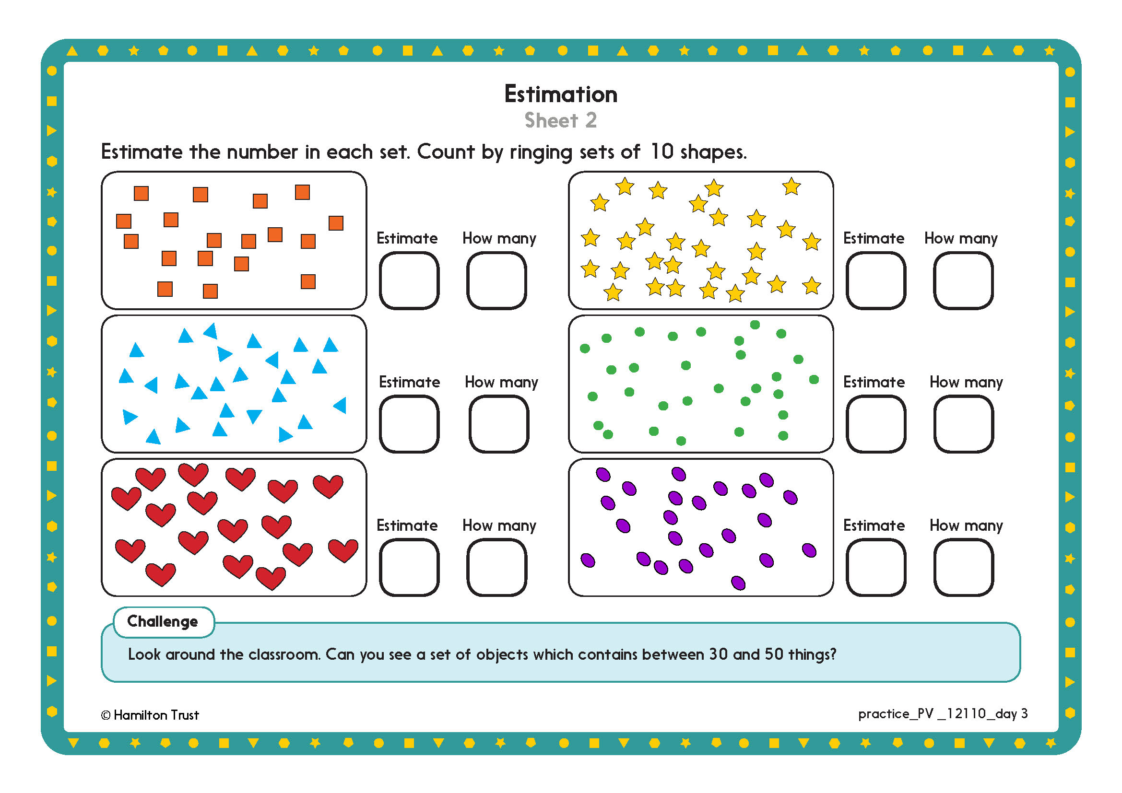

Challenge
Notes:
The Practice Sheet on this slide is suitable for most Y2 children.
Differentiated PRACTICE WORKSHEETS are available on Hamilton’s website in this unit’s PROCEDURAL FLUENCY box.
WT/ARE/GD: Estimation Sheet 2

Slide 17

Place Value
Counting and estimation
Well Done!
Objectives
Count, read and write numbers to 20 in numerals.
Identify and place 2-digit numbers on a number line. Compare and order numbers to 100.
Make reliable estimates of numbers up to 20.
Count in 10s from 1-digit and 2-digit numbers.
Order and compare numbers to 20 using a line.
Make reliable estimates of numbers up to 100.

